Slide 1
Nutrition Communications & Advocacy Workshop
27 & 28 September 2016

Slide 2
Introductions & Meeting Objectives
Notes:
Weber Shandwick: who we are, and why we’re here. What is a communications agency?
We are storytellers – Nutrition is a wonderful story to tell
Very quick recap of the process so far – emphasising that this has been a collaborative process with partners around the world, including input from PANITA
Participant introductions: open to the floor

Slide 3
Why are we here?
Our aim is to identify a more effective way to talk about nutrition…
…so that we can engage with people outside of the nutrition community…
…making nutrition a high priority in your country.
Notes:
About getting people beyond echo chamber (explain what an echo chamber is) of usual suspects...to engage with this issue outside the nutrition community – you’ve got a bunch of experts and tech expertise but we needed to break out of this and create work that would also help build a coherent voice/message...

Slide 4
Meeting objectives
By the end of this meeting, you will:
Have a good understanding of the basic principles of media relations and advocacy
Be introduced to the ‘nutrition story’ and related materials, as well as how to tailor and use them in the Tanzanian context
Have the tools you need to develop your own media & advocacy action plans
Understand how to draft strong success stories
Notes:
Why are we here today?

Slide 5
Day 1 Agenda
Timing | Topic
09.00 – 09.30 | Introductions & meeting objectives
09.30 – 10.30 | Introduction to storytelling & principles of media relations
10.30 – 10.45 | Coffee break
10.45 – 11.15 | Media relations in Tanzania
11.15 – 12.15 | The nutrition story
12.15 – 13.30 | Lunch
13.30 – 15.00 | Panel discussion: Effective storytelling
15.00 – 15.30 | Media & interview techniques
15.30 – 16.30 | Media interview practice
16.30 – 16.45 | Summary & close

Slide 6
Day 2 Agenda
Timing | Topic
09.00 – 09.15 | Day 1 recap & Day 2 objectives
09.15 – 09.45 | Introduction to advocacy & steps involved in successful advocacy
09.45 – 10.30 | Nutrition advocacy in Tanzania
10.30 – 11.30 | Developing strong case studies
11.30 – 12.00 | Putting theory into practice – individual level
12.00 – 13.00 | Lunch
13.00 – 14.00 | Putting theory into practice – group level
14.00 – 14.15 | Summary & close

Slide 7
Introduction to storytelling &
principles of media relations

Slide 8
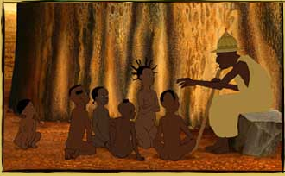
Storytelling
Stories have been used since ancient times to relate meaning to people’s lives
Storytelling pre-dates writing with stories shared in every culture in history through fairy tales, folktales, legends and fables
Notes:
Telling a compelling story is about making a CONNECTION with your audience, ENGAGING with them and getting their ATTENTION. The desired outcome is to INFLUENCE their behaviour in the way we want.
We can take a STEP BACK TO ORIGIN OF STORYTELLING. STORIES = LEARNING TOOLS FOR CHILDREN.
Every culture around the world has an amazingly rich HERITAGE of fairy tales and local stories. We’re all FAMILIAR with storytelling because we’ve been told them or passed them on ourselves from a very early age.
Stories help us:
LEARN HOW TO BEHAVE
TEACH US WHAT IS RIGHT AND WRONG
SET CULTURAL BOUNDARIES
EXPRESS VALUES
[Image: Storytelling scene from the African folktale "Kirikou & the Sorceress“]
Tanzania
“Legends tell of cultural heroes and important ancestors who were intelligent, courageous and generous. Young people learn about these illustrious ancestors through story telling. Among the Bahaya, the young groom researches his family history that has been preserved and passed down through legends and chooses an important ancestor that he will try to emulate and that will be his role model. In a very real sense, these ancestors participate and influence the lives of people today.”
“Among the Haya ...there is a standard opening formula before a narrative is told. The audience says, "See so that we may see", before the start of a folk tale.”
“Riddles are not just a form of entertainment, they play an important role in the social and cultural education of children. Riddles are also useful tools in children's cognitive development. They teach rules of behavior, explain and interpret natural phenomenon, and are a socially sanctioned avenue for questioning social taboos and restricted subjects. In the educational role, riddles provide a safe avenue for transmitting restricted information as well as intimate and vital knowledge. Among the Chagga, for example, elders explain that riddles are for entertainment, but they also point out that an adept at riddling acquires social respect and is considered a master in manipulating social knowledge.”
Tanzania Folklore, East African Living Encyclopedia

Slide 9
Modern storytelling
We have more ways to tell our story than ever before
BUT that also means it’s harder than ever to get ourselves heard
Notes:
Modern storytelling has a broad purview. In addition to its traditional forms (fairytales, folktales, mythology, legends, fables etc.), it has extended itself to representing history, personal narrative, political commentary, and evolving cultural norms. Contemporary storytelling is also widely used to address educational objectives.^{[2]} New forms of media are creating new way for people are able to record, express, and consume stories. Games and other digital platforms, such as those used in interactive fiction or interactive storytelling, may be used to position the user as a character within a bigger world. Documentaries, including interactive web documentaries, employ storytelling narrative techniques to communicate information about their topic.
In Tanzania:
- Tanzania's media scene, once small and largely state-controlled, developed rapidly following the advent of the multi-party era in the mid-1990s.
As with several other countries, radio penetration stays broadly similar across the time period but TV penetration increases. Internet access has increased considerably over the same time period (2006-2016) [4% internet access in 2011 vs. projected 25% in 2016; 3% access to a computer in 2011 vs. projected 25% in 2016]

Slide 10
Why do we need a story?
Good communications is about good storytelling
It gives meaning to our topic
Consistency in how we talk and clarity in what we’re asking for
Helps us be more relevant to our audience(s)
Nutrition is a complex issue – a good, clear story of what it is, why it matters, and how we can address it is critical in order to successfully make the case to those outside the nutrition community.
Nutrition is a multi-sectorial issue – we need a story that can be understood by different audiences, e.g. government officials in finance, agriculture, health, education, etc.
Why a story about nutrition?

Slide 11
The six steps to a story

Slide 12
Stimulating action
Inform
Think
Engage
Feel
Inspire
Act

Slide 13
Capturing hearts & minds
Emotional
Rational
‘

Slide 14
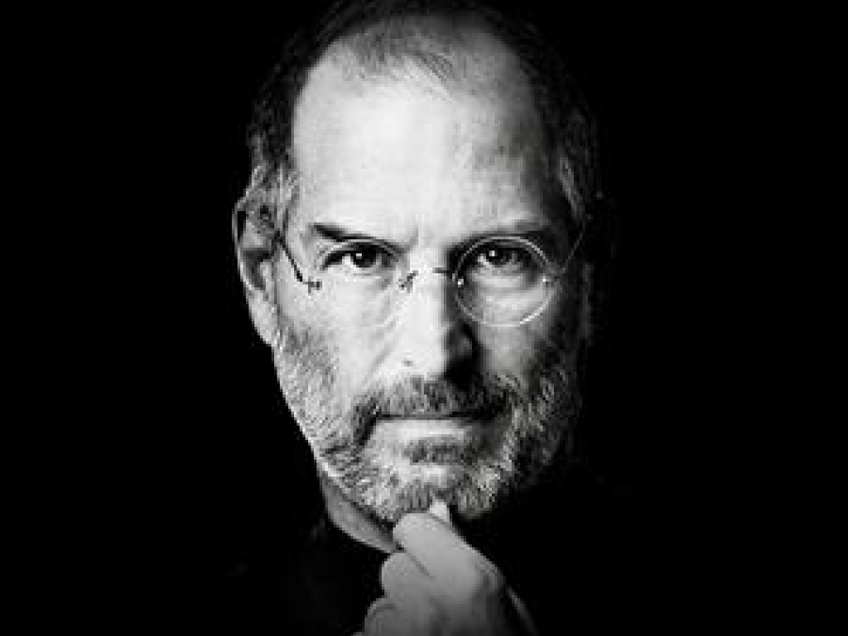
WE NEED TO BE RATIONAL AND EMOTIONAL
Rational because…
Emotional because…
Statistics and research make people believe you
Humans (vs. other species) respond to stories with strong emotional hooks.
People take action based if they believe the information.
Emotion helps elevate your message and its value.
Facts provide a common ground of understanding.
…and creates sympathy and credibility for the messenger.
Notes:
But we need to balance the rational with the emotional. I use Steve Jobs here because he lived this thinking, he understood that technical brilliance isn’t enough, that a story for the brand is essential. After all, there are some outstanding gadget manufacturers out there, many making arguably better products than Apple, yet none have even touched on their dominance of the sector.
However, don’t take my word for it. You may have heard of Nobel Prize Winner, Professor Daniel Kahneman – best known for his 2011 book ‘Thinking Fast, Thinking Slow’ which was based on 30 years of peer reviewed research.
In this he describes two systems that govern how the mind works, one we control and one we do not. System 2 represents the conscious self that makes choices and decides what to do. System 1 represents the instinctual mental events that allow us to make quick decisions with little mental energy. We could not survive without System 1 and yet it often causes us to make systematic errors in specific situations.
So, we may think of ourselves as purely rational beings but the fact is we are not – our cave man, instinctive brain has as much of a role to play as our rational thoughts.

Slide 15
COMMON THREAD
An ‘ask’
A strategy behind the creative with a clear call to action
Zeitgeist
Connection with a social / cultural trend
Personal story
A clear, compelling story – putting a person’s voice at the centre to capture hearts and minds

Slide 16
Coffee Break

Slide 17
The Nutrition story
www.NutritionSpace.org

Slide 18
Approach to the scope of work
Ways of Working: a collaborative and iterative process with partners around the world, especially the Global South
Global Toolkit: a flexible toolkit of white-label & open-source materials - not a ‘branded campaign - to ensure widespread adoption
SUN CSO Toolkit & Tailored Communications Support
Maximizing major advocacy global/regional moments
Media relations

Slide 19
A collaborative effort.
With thanks to representatives from:
Scaling Up Nutrition (SUN) Movement | Global Citizen
1,000 Days (US) | Jamie Oliver Food Foundation
The Bill & Melinda Gates Foundation | Save the Children (UK)
The Children’s Investment Fund Foundation | Global Nutrition Report
Action Against Hunger | Power of Nutrition
JAAGO Foundation | ONE
Partnership for Nutrition in Tanzania (Panita) | UNICEF
Hellen Keller International | RESULTS UK
Concern Worldwide
www.nutritionspace.org

Slide 20
The nutrition story: change in direction
Enough food
Enough nutrients
Sole focus on outside story
Incorporate inside story
Technical jargon for the initiated
Accessible language for all
Problem-focused (the ‘why’)
More solution-oriented (the ’how’)
Big to do list with big price tag
Priorities and focus

Slide 21
A flexible communications framework
NUTRITION NARRATIVE
What?
DEFINITION
PILLAR 1
PILLAR 2
PILLAR 3
Our Story
Why?
GUIDING APPROACH & INTERVENTIONS
How?
CREATIVE PLATFORM & TOOLKIT
A unifying thread in materials
How We Tell It
CALLS TO ACTION
21
Notes:
A narrative is the anchor point from which all communication must originate.
Whilst specific messages will differ by audience, geography and agenda, everything we say is guided by the themes, tone, pillars and (critically) simplicity of the narrative.

Slide 22
WHAT is good nutrition?
Good nutrition is not about how much food is available to consume, but rather about ensuring the right nutrients go into the body, and also stay in.
Good nutrition is:
About ensuring mothers and children receive the vital ingredients they need to thrive, whether these come from a varied diet, breastfeeding, or supplementation.
Not about how much food is available to consume, but rather about ensuring the right nutrients go into the body (e.g. breastfeeding), but also stay in (e.g. anti-diarrheal rehydration treatments).
Put at risk by anything that prevents this process (e.g. infectious diseases like malaria can waste nutrients by hindering their absorption or diverting them to deal with high fevers).

Slide 23
WHY does it matter?
The right nutrients for both mother and baby in the first 1,000 days from conception to the second birthday sets the stage for physical, emotional and intellectual development for that child’s entire life.
Argument 1
Argument 2
Argument 3
PROTECTION
Good nutrition helps build a child’s internal defenses
Good nutrition builds strong immune systems, supercharging children’s chances of survival and protecting them their whole lives.
POTENTIAL
Good nutrition helps children be all they can be
Good nutrition helps develop strong brains and bodies, allowing this generation the opportunity to not just survive, but also to reach their full potential throughout life.
PROGRESS
Good nutrition helps nations be all they can be
Good nutrition for children impacts everyone. As children grow strong, so do communities and countries, thus ending the cycle of poverty.
Notes:
The story includes three supporting arguments that provide a clear, compelling starting point for conversations with our audiences on why this issue is important.
These are building blocks that can be used flexibly – we may rely on one theme, or use a combination, differently for different audiences.

Slide 24
Key implications for how we communicate
Do:
Don’t:
Position impact of poor nutrition around the damage on the inside, with stunting and wasting as proxy measures.
Position stunting and wasting as the two things that we are trying to stop as ends in themselves.
Use the impact of poor nutrition on the immune system as a reason to believe why it is the underlying cause of nearly half of child deaths. This applies for both wasting and stunting.
Tell people poor nutrition is the underlying cause of nearly half of child deaths without giving them a concrete reason to believe.
Talk about how good nutrition helps some of our vital organs develop and grow, as that makes it feel distinctive and concrete.
Use generic growth messages that could be used for the majority of global health issues.
Communicate stories of how we are on our way to making an impact.
Don’t just leave people dwelling on the problem.
Use the impact of 1,000 days not just on rate of survival, but on losses that cannot be regained, to inject urgency and narrow window of opportunity to act.
Fall back on using hunger as the urgent story.

Slide 25
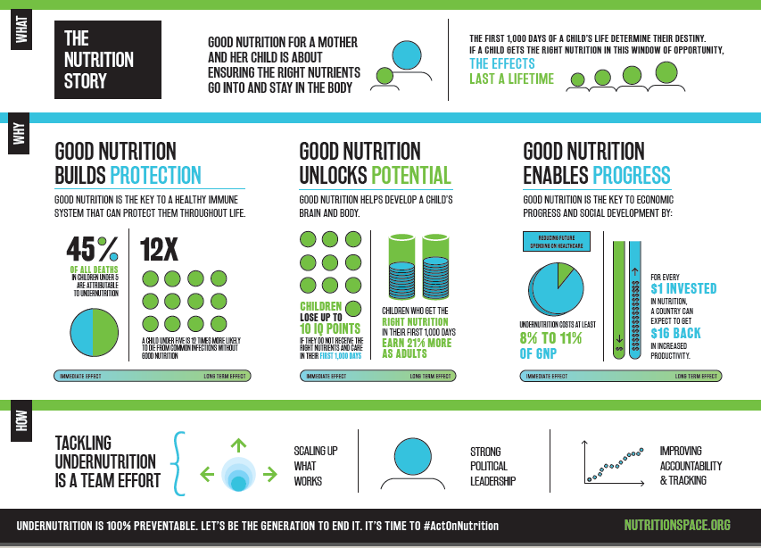

Slide 26
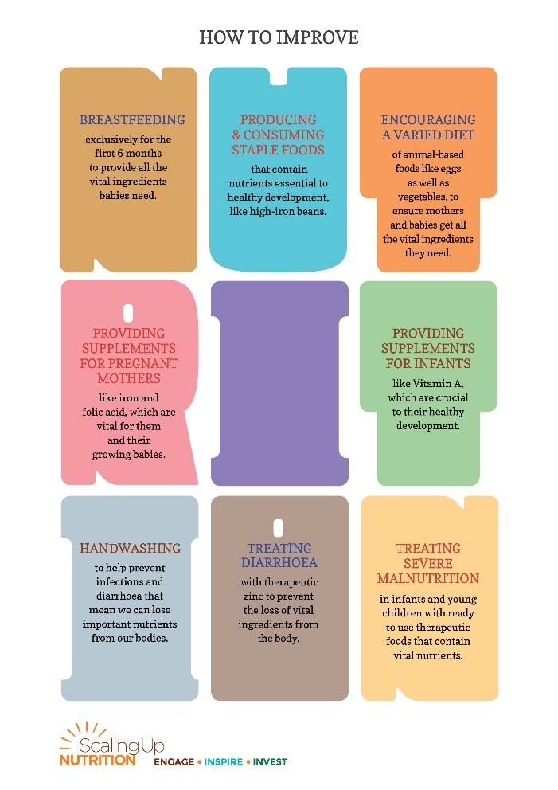
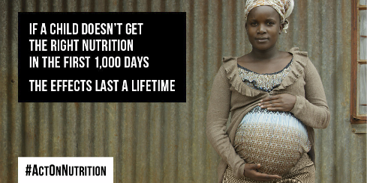
Toolkit made up of range of materials and formats
Video
Print
Graphics/infographics
Social media
Notes:
Insert Link Here

Slide 27
Panel discussion: Effective storytelling

Slide 28
Lunch Break

Slide 29
Sample advocacy strategy: Outline
What are you trying to achieve?
What process could deliver that?
Strategic approach
Targets and allies
Timeline
Priority activities and outputs
Risks and mitigations

Slide 30
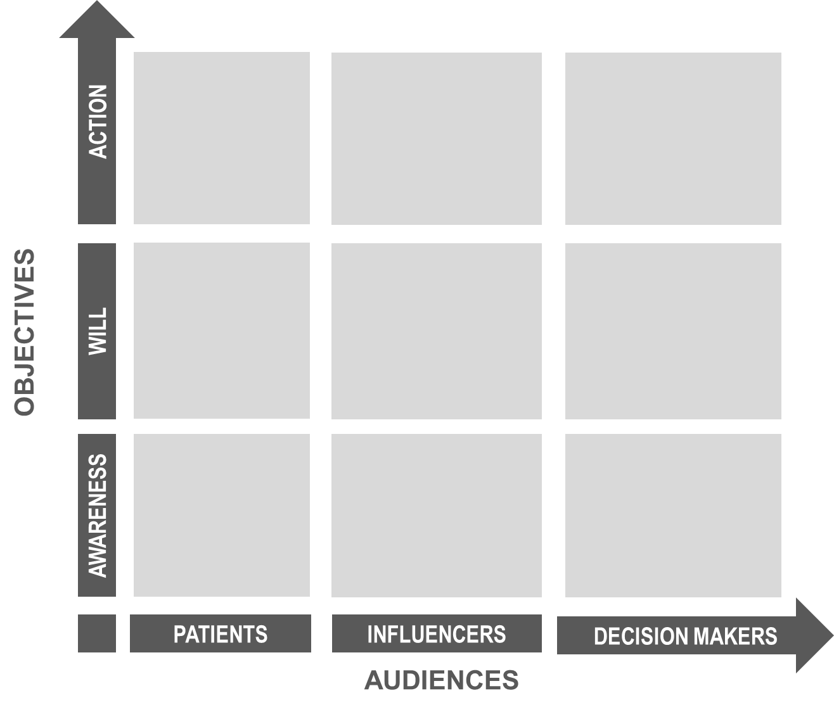
Advocacy strategy: Framework
Lobbying
Community mobilisation
Coalition building
Media advocacy
Conference speaking
Public forums
Awareness campaigns
Influencer education
Policy-maker education
Community education
PEOPLE
Notes:
Campaign framework: goal, objectives, audiences, asks, tactics

Slide 31
MEDIA STRATEGY

Slide 32
“If you talk to a man in a language he understands, that goes to his head.
If you talk to a man in his language, that goes to his heart.”
- Nelson Mandela

Slide 33
Setting clear media relations objectives
Who is your end audience?
What media are likely to influence your target audience?
Using media as a channel through which to reach our target audiences
What do you want your audience to do as a result of hearing your messages via the media?
What does success look like? How will you measure how successful your activities were?

Slide 34
Media engagement tactics
Media release / news story pitch
Desk-side briefing
Field visit
Feature story sell-in
Roundtables, workshops, media briefings
Journalist ‘training’ on key topic

Slide 35
What makes a good message?
Succinct, e.g., average sound bite is five seconds, print quotations = 25 words
Delivered with passion
No jargon / use language your audience understands
Talk about the benefits, not the process
Vivid example that paints a picture: analogies, stories and metaphors
Specify the ‘ask’ – what you are asking for, from your end audience
Notes:
So what makes a good quote: don’t over answer
Five seconds- that doesn’t mean talk in 5 second soundbites. Answer can be 20-30 seconds but the reporter may paraphrase your first 20 seconds and just capture the rest in the bite.
Passion- you can’t be taken seriously if your delivery is devoid of energy and enthusiasm
No jargon- keep it simple
Benefits- process is boring, that’s why recipes are on the back of the box
Examples- reporters love those two words “for example”, paint a picture that readers can visualize, takes complex sometimes abstract concept and makes it understandable “life is like a box of chocolates”
According to Max Atkinson, the British speech researcher, when a speaker utters the phrase “for example” there is a noticeable movement among crowds. Atkinson videotapes audiences listening to speakers and what he finds is that there is a distinct movement of heads when that phrase is spoken. Audience members are literally jerking their heads up to hear what comes next.
Audiences love example because it allows them to leave the boring world of abstraction where the speaker has been dwelling. Examples allow the audience member to see if he or she has really understood the speaker after all.
And the final benefit of “For example” for audience member and speaker alike is that it means there will be a temporary ceasefire when it comes to the speaker delivering more and more data. Because an example is not about delivering new data; it is about putting together a real life picture of the data and facts you described a moment ago.

Slide 36
Evaluating your media relations efforts
Set markers against which to measure the impact of your work BEFORE you start any media activities
This is critical in order to:
Measure the success of your activities
Identify key learnings for future activities
Keep a recording template for any media coverage you secure
Date | Publication | Author | Tone of voice (positive, negative, neutral) | Key message pick-up | Audience reach figures

Slide 37
Media relations for nutrition in Tanzania

Slide 38
Reporting in Tanzania
Journalists tend to report on ‘face value’ of stories
For political stories: weekly investigative papers in English and Kiswahili, which provide in-depth issues analysis
In-depth features and/or investigative stories are also generated from reports by NGOs or organizations.
Some of the reports in the nutrition space that have become covered include: UNICEF Nutritional Survey, REPOA (research on Poverty Alleviation) Global Nutritional Report. ,
In the current regime, to make a nutrition agenda a polictical story, we will need to line the economic effect of adverse nutrition to development and also show how it affects key focus sectors of the government – Education, Health.

Slide 39
Media structure
Print, TV, & radio outlets located in Dar es Salaam and regionally
Newspapers & TV address mostly the elite and middle classes
Main newspapers: Mwananchi (Kiswahili) & The Guardian (English)
Main TV channels: ITV, TBC (government-operated)
National newspaper market divided into four parts:
Weekly business newspapers
Weekly political analysis newspapers
General news covering a wide number of topics
Weekly sports and entertainment newspapers
Popularity of regional newspapers
Note: Policy makers take time to read newspapers. TV habit is mainly around news broadcasts.
Notes:
Tanzania’s media (print, TV, radio) are located mainly in Dar es Salaam, but also have a vibrant regional media.
In addition there are regional newspapers that have greater readership within the regions

Slide 40
Media structure
Radio is the main medium for most Tanzanians
Radio One, TBC FM
Growing blogging community for news & entertainment
Social media (Facebook, Twitter, Instagram) increasing in popularity
Internet accessible only in major towns and available mainly in office locations - not readily available to local Tanzanians
HOWEVER: mobile telephone operators have revolutionised internet services by introducing modem internet as well as internet services on mobile phones
Online newspapers and blogs dominate online media
Notes:
Social media (Facebook, Twitter, Instagram) platforms growing considerably due to the availability of affordable smartphones especially among the youth and urban areas communities

Slide 41
Top National Daily Press:
Mwananchi
Print run: 100,000
Main focus: general news, political information
Readership: General public, educated and business traders
Language: Kiswahili
Habari Leo
Print run: 20,000
Main focus: General news, political information,
Readership: general public, government owned paper
Language: Kiswahili
Nipashe
Print run: 40,000
Main focus: general news, political information
Readership: general public, educated and business traders
Language: Kiswahili
Notes:
The most read newspaper is Mwananchi. Its considered authoritative and balanced.

Slide 42
Top National Daily Press:
The Citizen
Print run: 25,000
Main focus: general news, political news, sports and entertainment
Readership: general public with an interest with opposition politics
Language: English
Daily News
Print run: 25,000
Main focus: general news, political information; business, special magazine pull-outs
Readership: highly educated parts of society as well as business leaders. Government owned paper
Language: English
The Guardian
Print run: 25,000
Main focus: general news, political information, economic news, business information
Language: English
Notes:
Policy makers will read Daily News, as this is their paper. However, the most authoritative paper is is the Citizen Newspaper

Slide 43
News agencies
International Agencies based in Dar:
BBC Radio Kiswahili
DW
Voice of America
Reuters
Radio France International
Notes:
Tanzania correspondents for the main news agencies
Organised in order of preference.
Reuters – mainly TV storeies

Slide 44
Broadcast
Seven TV Channels: general news and programming; entertainment; and religious
Most important is ITV with nationwide coverage. Other nationwide stations are Star TV , TBC
60% of content is local programming and the other 40% sources programming
The best shows to reach policy makers are discsion forums – mornig and evening.
There are over 15 radio broadcasts based in Dar es Salaam with another 30 regional based radio stations.
The most important national radio broadcast are TBC radio, RFA, Radio One.
The radio stations mainly provide entertainment. Each station has a weekly heath segment on issues affecting society.

Slide 45
Top 5 national TV stations
ITV – audience share: 80%; organizational form: public; main focus: Record serves all broadcasts of public interest (News, Films, Sports, Soap operas, reality shows, etc.)
Star TV – audience share: 70%; organizational form: public; main focus: Music and entertainment
TBC 1– audience share: 50%; organizational form: public; main focus: TBC1 serves all broadcasts of public interest (News, Films, Sports, Soap operas, reality shows, etc.)

Slide 46
Top news broadcast
RFA – organizational form: private company main focus: politics, entertainment, current affairs, economy, sports, business
TBC FM – organizational form: public; main focus: politics, current affairs, economy, sports, business
Radio One – organizational form: private company; main focus: politics, current affairs, economy, sports, business

Slide 47
We need to include only the blogs that are likely to reach and influence policymakers in the country. E.g. ‘Bongo Celebrity’ doesn’t seem that relevant…
Top online blogs
Global publishers – Entertainment, fashion, gossip
Michuzi Blog – main focus: political news, business, social events,
Jamii Forums main focus: political news, business discussions
Full Shangwe –main focus: political news, entertainment,
Haki Blog – main focus: justice issues in various sectors of the country.

Slide 48
Social media
Facebook and Twitter are growing as key communication channels
Blogs are mainly used by 13–45year olds
Main communication in Kiswahili, though social networks are increasingly in English
More professionals are using LinkedIn
Political campaigns during the last election also used Facebook and Twitter, as party leaders attempted to reach youth

Slide 49
Tips for success
Tanzanian journalists often looking for ready-to-use information that can be used for newspaper articles
In addition, they expect to be facilitated to attend or cover your news functions
Journalists and editors are receptive to the idea of exclusive pitches, however the basic understanding is that nothing is done for free
Journalists also accept invitations for lunches and breakfasts with executives
Very few journalists are specialized in specific topics or segments – most are ‘generalists’
Respecting deadlines is essential for keeping a good relationship with them

Slide 50
Key Nutrition Media
Some of the key nutrition agenda media in Tanzania include:
Radio One - Health Segment (Wednesday)
Jambo Tanzania on TBC
Expert Discussion Shows – ITV, Star TV, Channel 10
Magic FM
All Newspapers – Wednesday and Thursdays
Citizen – Saturday Magazine
Habari Leo – Women's magazine
Dodoma FM (with government moving to Dodoma, this station popularity as a news source for people living in Dododma)

Slide 51
Media & interview techniques

Slide 52
Know why you are doing an interview
What’s your objective?
Shape attitudes, spur action, gain mindshare
Who are you trying to reach?
Identify why they’ll care (make it relevant to them)
Why you, specifically?
Communicate essential concepts
Keep it simple; only two or three concepts will resonate
Notes:
Many people do interviews without really thinking why
What’s your objective?
Who are you trying to reach?
What would you view as a good outcome?
Why you, specifically?
The spokesman is in control
Stay in the background
Speak minimally at key moments only (print)
Only intervene to:
Protect your spokesperson from trouble
Correct an important error
Steer towards a message or opportunity

Slide 53
Controlling the dialogue
Remember your story and focus on delivering it.
Pause before answering…say second thing that comes into your mind
Don’t just ‘answer the question’, it’s a wasted opportunity!
Use your first answer to start your story, don’t wait for an invitation
Steer the discussion to focus on your key points
Repeat, repeat, repeat your key messages

Slide 54
Bridging
ACKNOWLEDGE: Keep it short & direct
BRIDGE: Your phrase to bridge to …
CONTROL: … your story

Slide 55
Flagging
Every question is an opportunity to communicate our core message; flagging makes sure your audience knows what it is
Flagging is a simple technique that emphasizes a point you want the your audience to remember
“The point I really want to make is this …”
“The most important thing to remember about this is…”
“If you to take one thing away from this conversation, it should be…”

Slide 56
What makes a good message? Recap:
Succinct
Average length of a sound bite is five seconds
Print quotations rarely exceed 25 words
Delivered with passion
Lacks jargon
Speaks to the benefits, not the process
Vivid example that paints a picture: analogies, stories and metaphors
Notes:
So what makes a good quote: don’t over answer
Five seconds- that doesn’t mean talk in 5 second soundbites. Answer can be 20-30 seconds but the reporter may paraphrase your first 20 seconds and just capture the rest in the bite.
Passion- you can’t be taken seriously if your delivery is devoid of energy and enthusiasm
No jargon- keep it simple
Benefits- process is boring, that’s why recipes are on the back of the box
Examples- reporters love those two words “for example”, paint a picture that readers can visualize, takes complex sometimes abstract concept and makes it understandable “life is like a box of chocolates”
According to Max Atkinson, the British speech researcher, when a speaker utters the phrase “for example” there is a noticeable movement among crowds. Atkinson videotapes audiences listening to speakers and what he finds is that there is a distinct movement of heads when that phrase is spoken. Audience members are literally jerking their heads up to hear what comes next.
Audiences love example because it allows them to leave the boring world of abstraction where the speaker has been dwelling. Examples allow the audience member to see if he or she has really understood the speaker after all.
And the final benefit of “For example” for audience member and speaker alike is that it means there will be a temporary ceasefire when it comes to the speaker delivering more and more data. Because an example is not about delivering new data; it is about putting together a real life picture of the data and facts you described a moment ago.

Slide 57
How to answer
Use first answer to get your messages out
Your one chance to be sure of expressing all concepts
All other answers should be brief
Stick to your agenda
Acknowledge the question, but move quickly, credibly to message
Your mission is transition
Find common ground; link a word or topic area in the question to one of your messages
Focus on message hierarchy
Don’t forget to return to the big picture

Slide 58
Interview simulations
Scenario 1: You are calling a journalist to announce the GNR launch. How do you sell in your story? [Jackie, pls give example of journalist & outlet]
Scenario 2: You are invited for a live interview at the Jambo Tanzania show, on TBC1, to provide input on… [Jackie pls provide details – why would Jambo Tanzania invite a CSO to talk about nutrition?]
Scenario 3: You are calling journalist Kasumin Ludger from The Citizen Newspapers to… [Is this an outlet likely to be read by policymakers?]

Slide 59
Day 1: Summary & Close

Slide 60
Nutrition Communications & Advocacy Workshop
Day Two: 28 September 2016

Slide 61
Today’s activities
Media interviews
Outline for an action plan
Panita strategy/targets
Advocacy overview: what is advocacy?
Small group work/Report-back – completing the action plan
Media interviews
Case studies
Wrap-up & close

Slide 62
Day 2 Agenda
Timing | Topic
08.30 – 09.00 | Media interviews (part 1)
09.00 – 10.00 | Advocacy overview
10.00 – 10.15 | Tea break
10.15 – 11.00 | Working on action plan
11.00 – 12.00 | Case studies
12.00 – 12.30 | Report backs
12.30 – 13.30 | Lunch
13.30 – 14.30 | Media interviews (part 2)
14.30 – 15.00 | Wrap-up
Notes:
Why are we here today?

Slide 63
Interview DO’s
Tell the journalist a story
Be simple and clear: talk in terms people understand
Be positive, enthusiastic, and show you believe in what you’re saying: put your heart and mind into it
Be firm, decisive, and say only what you want
Steer the discussion: lead to where you want to go
Weave key messages into answers; repetition resonates
At the end, take the opportunity to repeat your messages one more time

Slide 64
Interview DON’Ts
Don’t hold an interview unprepared, and don’t lie
‘I don’t know’ is a much better response than making something up
Don’t share too many details. Know when to stop
It’s ok to close out a repeated question you’ve already addressed with, e.g. ‘as I said’, or ‘it really is too early to tell’
Don’t get defensive
Don’t use jargon or buzzwords
Don’t speculate or comment on rumours
Don’t assume you can speak ‘off the record’: there is no such thing!

Slide 65
Interview checklist
Do
Prepare
Take control
Don’t
Let your guard down or lose your temper
Repeat key messages
Hope you can ‘wing it’
Set an end to the interview
Lie, if you don’t know the answer
Speak ‘off the record’
Notes:
Pause before answering… sometimes, say second thing that comes into your mind
Pausing helps you focus
Your first answer can be off-message…or even defensive
Steer the discussion
Advance your agenda as you answer
Resist the temptation just to respond to questions
Use your first answer to market your key messages
This is your one chance to be sure of expressing all concepts

Slide 66
Practice makes perfect: Interview simulations
Notes:
Participants work in pairs, to role-play a reporter interview. Swap roles.
Criteria for journalists: was the speaker:
- Authentic?
- Believable?
- Passionate?
- Clear?

Slide 67
Critique & discussion
Notes:
Group report-back: what worked well? What needs improvement?

Slide 68
Developing your advocacy action plan
Define the policy change/resource investment you want
Identify your target audience
Develop messages
Lay out an approach to deliver your call to action

Slide 69
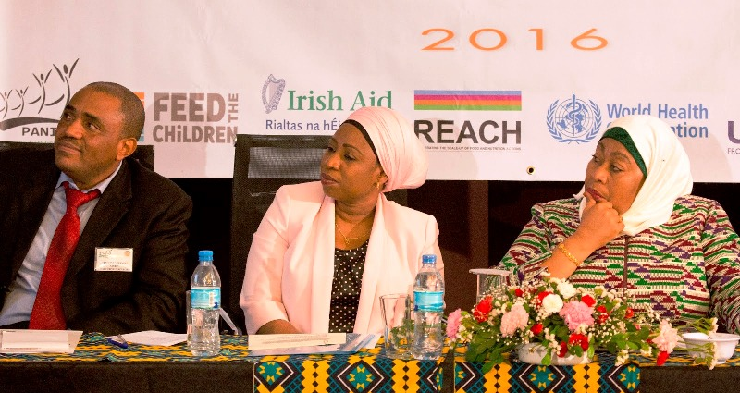
You already do advocacy

Slide 70
PANITA’s advocacy strategy
Overall Policy Goals– what advocacy will seek to achieve
To reduce malnutrition among children under-5 and women of reproductive age in line with 2015 National Nutrition Strategy targets;
To reduce stunting by 12% by 2025 (in-line with the WHO target).

Slide 71
PANITA’s advocacy targets
African organizations/institutions in Addis (AU) plus the international nutrition bodies/institutions
Bilateral and international organizations, NGOs – int'l and local – DFID, SIDA, CIDA, World Bank, plus UNICEF, WFP, Irish Aid etc.
Prime Minister’s office, Ministry of Education and Social Affairs, Ministry of Finance, Ministry of Agriculture, Ministry of Health, Ministry of Community Development, Ministry of Legal and Constitutional Affairs, government run institutions (TFNC, TASAF)
Relevant MPs from Parliament Committees including Standing Committees
Regional, district and local community structures
Media including TAJOC representatives
Community members
Other influential people (experts in particular fields, SC consultants, University professors)

Slide 72
Introduction to advocacy:
Steps involved in successful advocacy

Slide 73
What is advocacy?
“The actions people or organizations take to influence decision-making that help create a desired change”
Advocacy can take place at the local, regional, state, national, and international levels
Advocacy has the power to build broad support across sectors for a specific issue – like investment in nutrition
The key to advocacy success? Make it relevant!

Slide 74
Key principles of successful advocacy
Evidence-based
Targets the right decision-makers
Simplicity
Relatability
Collaborations
Timing
Notes:
Evidence-based: builds credibility
Targets the right decision-makers: targets those who are able to effect change
Simplicity: less is more
Relatability: argument needs to relate to target audience’s interests / resonate with them
Collaborations: coordinated efforts can have stronger results
Timing: Need to get timing right, to maximise impact

Slide 75
Characteristics of Advocacy
Advocacy has to be directed at those who have the power to make the decisions and bring about results.
Advocates use many tools and techniques to direct their efforts. These include: generating and interpreting information, building alliances and coalitions, engaging in media advocacy, litigating and lobbying.
Advocates regularly ask something of others—within their group or those with the power to decide.
Actions by advocates create demands on political and policy systems. By doing so, conflicts may be generated that otherwise might be avoided.

Slide 76
Formulate your advocacy goal
Key elements of an advocacy goal
WHO do you want to see take action? | [Specify decision-makers]
WHAT kind of action do you want them to take? | [Outline what is needed to address the issue]
WHY is this change important? | [Present the supporting evidence]
WHEN does action need to be taken? | [Specify the timeline]

Slide 77
Identify your target audience: stakeholder mapping
Who are the influential actors in the field? Include potential supporters, opponents, neutral actors
Plot stakeholders to identify target audiences and potential partners
Very influential
Opposes your objective
Supports your objective
Least influential

Slide 78
Develop messages
Succinct
Average length of a sound bite is five seconds
Print quotations rarely exceed 25 words
Delivered with passion
Lacks jargon
Speaks to the benefits, not the process
Vivid example that paints a picture: analogies, stories and metaphors
Notes:
So what makes a good quote: don’t over answer
Five seconds- that doesn’t mean talk in 5 second soundbites. Answer can be 20-30 seconds but the reporter may paraphrase your first 20 seconds and just capture the rest in the bite.
Passion- you can’t be taken seriously if your delivery is devoid of energy and enthusiasm
No jargon- keep it simple
Benefits- process is boring, that’s why recipes are on the back of the box
Examples- reporters love those two words “for example”, paint a picture that readers can visualize, takes complex sometimes abstract concept and makes it understandable “life is like a box of chocolates”
According to Max Atkinson, the British speech researcher, when a speaker utters the phrase “for example” there is a noticeable movement among crowds. Atkinson videotapes audiences listening to speakers and what he finds is that there is a distinct movement of heads when that phrase is spoken. Audience members are literally jerking their heads up to hear what comes next.
Audiences love example because it allows them to leave the boring world of abstraction where the speaker has been dwelling. Examples allow the audience member to see if he or she has really understood the speaker after all.
And the final benefit of “For example” for audience member and speaker alike is that it means there will be a temporary ceasefire when it comes to the speaker delivering more and more data. Because an example is not about delivering new data; it is about putting together a real life picture of the data and facts you described a moment ago.

Slide 79
Advocacy strategy: Framework
Lobbying
Community mobilisation
Coalition building
Media advocacy
Conference speaking
Public forums
Awareness campaigns
Influencer education
Policy-maker education
Community education
PEOPLE
Notes:
Campaign framework: goal, objectives, audiences, asks, tactics

Slide 80
How to Advocate in Tanzania
Understand the power of cultural norms. As a predominantly male culture, you will need to use this norm to advance your agenda in Tanzania
Collaborate, Collaborate, Collaborate. The more diverse groups speak about Nutrition, the more the chances to advance your agenda
Take advantage of the “Hapa Ni Kazi Tu” slogan of the current government. The new government is committed to service delivery, so anyone who has an agenda that is progressive and investing in future generations will have an audience.
Work from bottom to top (community to national) and top to bottom. And top to bottom (national to community). Understand that the two sided flow of information is encouraged in the current government. Executives are expected to be on-top of their agendas.
Notes:
You will need to work with other institutions outside the “closed” nutrition sector to assist. Eg Academics, Women,
Seek to understand in local and national key influencers for a national agenda e.g National Agenda an Janeth Magufuli drive agenda (Mother, teacher, high profile?) She has not yet been identified with any agenda at the moment. At regional level, who can drive the agenda – DC or RC, Or Education Dept. Let data drive your selection process.
Work with government agencies/offices to learn what the government priority areas are.
There is ïntercompetition” a need to show that you are delivering. Nutrition is a simple agenda to achieve.

Slide 81
Putting theory into practice:
Individual level

Slide 82
Setting advocacy goal
What is the specific change or action I want decision-makers to make to help create the desired policy or funding change I am seeking?

Slide 83
Lunch break

Slide 84
Putting theory into practice:
Group level

Slide 85
Setting advocacy goal – group level
Report-back on individual advocacy goals
Working as a group, identify a primary advocacy goal all participants can work towards; and develop an action plan for achieving it

Slide 86
Developing strong case studies

Slide 87
Key considerations
Why do we need to share our success stories?
To demonstrate the impact of our work, as support for a particular ‘ask’, e.g. when asking policy makers to prioritise / invest in nutrition
What do you want others to remember?
Look at the ‘success story’ through your audience’s eyes: why does it matter? What is the benefit to them? E.g. why should an education minister care about a nutrition programme?
Data to support your case
Include hard facts on what you have achieved…
…and then take it to the next level: why does this matter?
What format will be more effective to present your success story in?

Slide 88
Key elements of a strong success story
Audience/Goal
Challenge faced
Solution
Results: and why they matter!

Slide 89
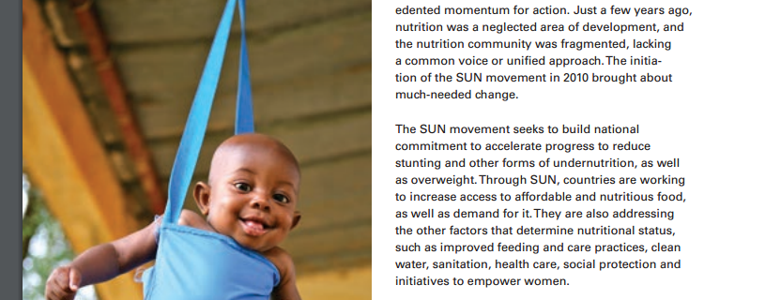
Example

Slide 90
Practical exercise
Drafting your own success stories!

Slide 91
Summary & close

Slide 92
Thank You

