Slide 1

Building Nutritious Food Baskets Project
Objective 1
Moses Mnzava, Margaret Benjamin, Godfrey Mulongo

Slide 2
Objective 1
Strengthen the enabling environment for investments in biofortified crops
1.1 Situational analysis and needs assessment concluded
    -country resource mobilization strategy/plan developed
    -country to establish mult-sectoral platform
1.2 Strengthen capacity of advocates
1.3 Implementation of the advocacy strategy
1.4 At least $5M committed for biofortification

Slide 3

Achievements
1.Situation analysis implementation
  1st draft shared ready for review
  Final report awaited
2. Advocacy – strategy awaited however the country coordinator
  initiated meetings with TFNC to position biofortification
  involved in the MNAP development process
  engaged in the JNR meeting and tabled biofortification for discussion

Slide 4
Achievement cont...
3. Meeting with National variety release committee
  advocacy on special criteria for release of bio fortified varieties; now this is included
4. Together with CIMMYT met with food processors for potential processing of maize products

Slide 5
Challenges
Initial SITAN cost under estimated; The time required to improve on the budget allocated delayed the SITAN process
Lack of released maize and bean varieties delayed advocacy for a food-basket

Slide 6
Plans
Finalize SITAN report and strategy
Identification of country advocates/champions
Establish a bio fortification platform
Engage with TFNC/PMO during planning and nutrition for resource allocation in the LGAs
Facilitate TFNC/PMO engagement with RAS on advocacy for biofortification and investment
Coordinate BNFB partners for meeting with TOSCI and ASA for fast-racking release of varieties

Slide 7
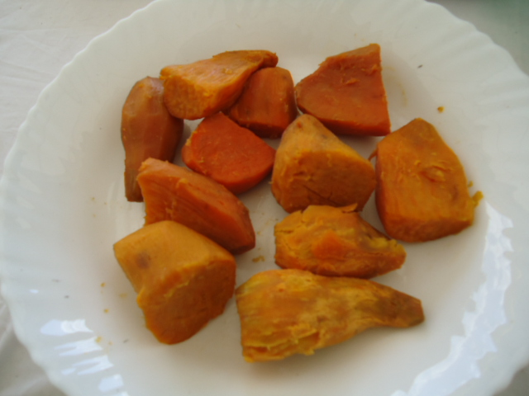
OBJECTIVE 2
K. Mtunda, N. Luambano, M. Yongolo, E. Mpayo and Margaret Benjamin
Sugarcane Research Institute-Kibaha
Presented at the annual meeting, 2-5 November 2016, Nigeria

Slide 8
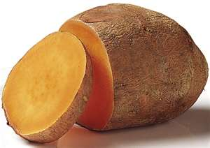

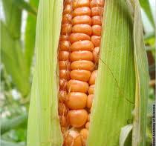
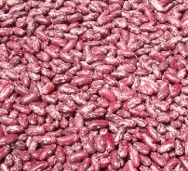
Objective 2:
Strengthened institutional and community capabilities to produce and consume biofortified
2.1. Strengthened capacities and competencies of investors and executing institutions
2.2. Enhanced awareness of and increased organizational action for bio-fortification
2.3. Biofortification increasingly mainstreamed in national nutrition programs / bio-fortified varieties released and utilized

Slide 9
Activities
Sugarcane Research Institute (SRI) is fully responsible for achieving the following outputs:
Continuous supply and maintenance of pre-basic OFSP seed.
  2.5 acres under multiplication at ARI-Hombolo
  0.75 acre under multiplication at 88 ground-Dodoma

Slide 10
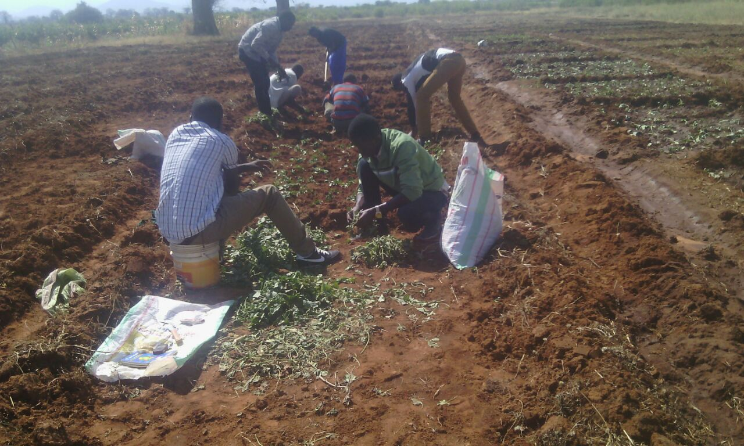
Planting 2.5 acres at ARI-Hombolo

Slide 11
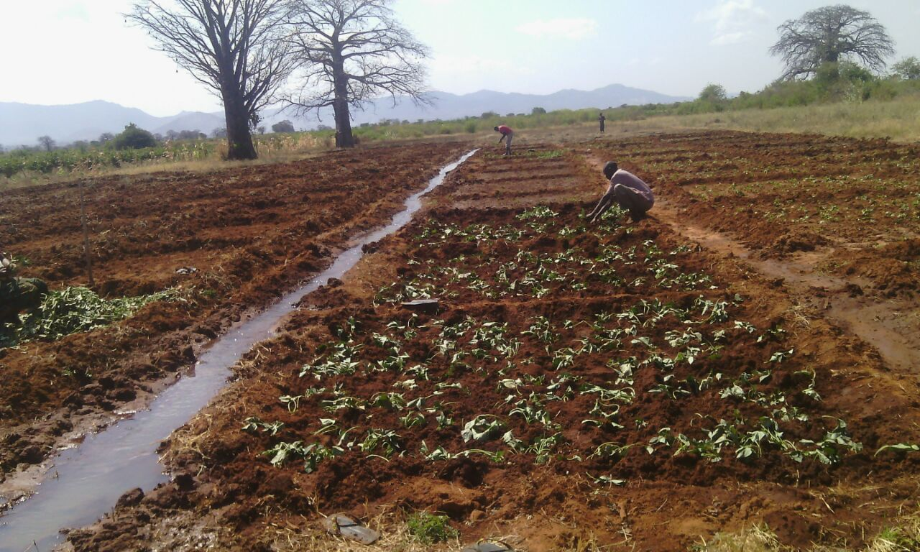

Slide 12
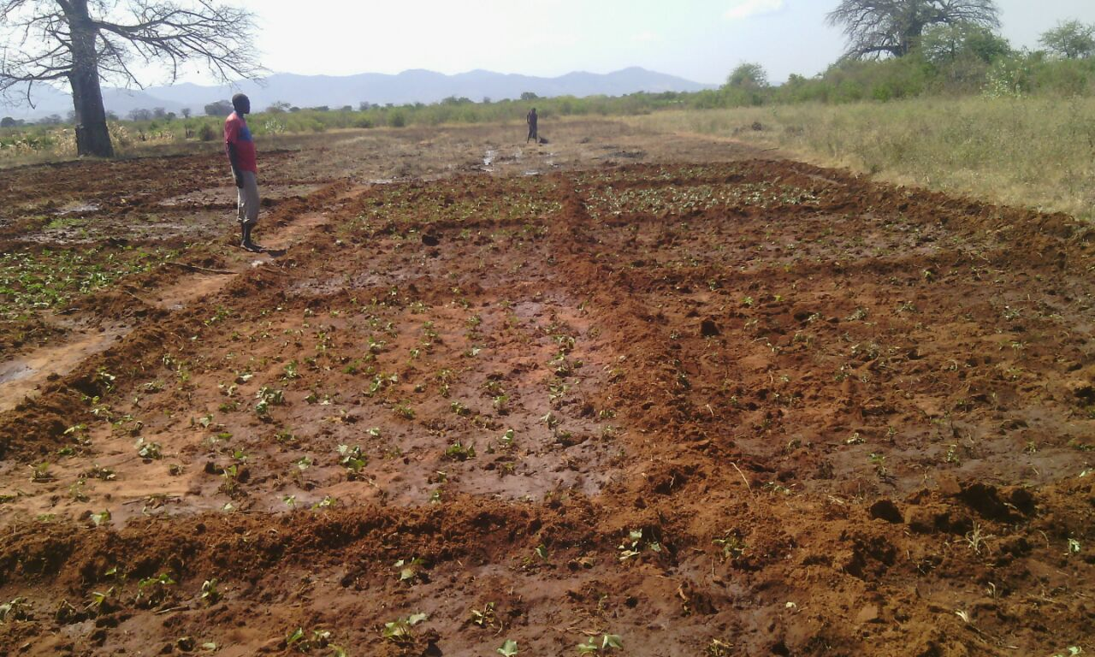

Slide 13
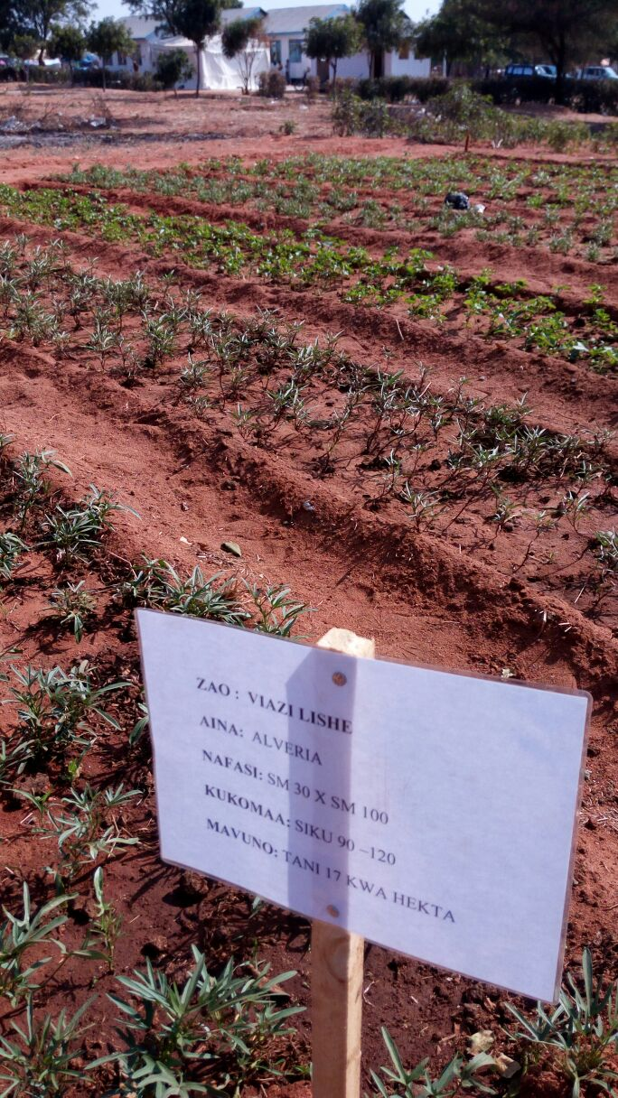
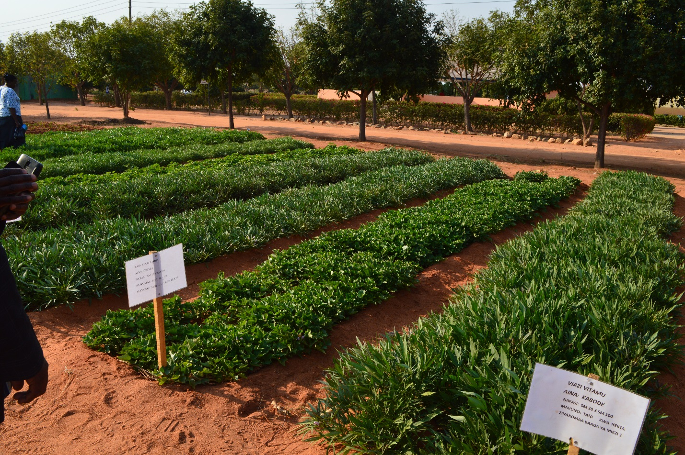
Demonstration plot at 88 ground Dodoma

Slide 14
Activities
Partners (decentralized vine suppliers, farmer groups) empowered to take full responsibility for basic OFSP seed production.
  Stepping down training between 25-27 September 2016: SRI in collaboration with CIP- trained 24 decentralized vine multipliers and 12 extension officers from Dodoma and Singida Regions (12 districts)

Slide 15
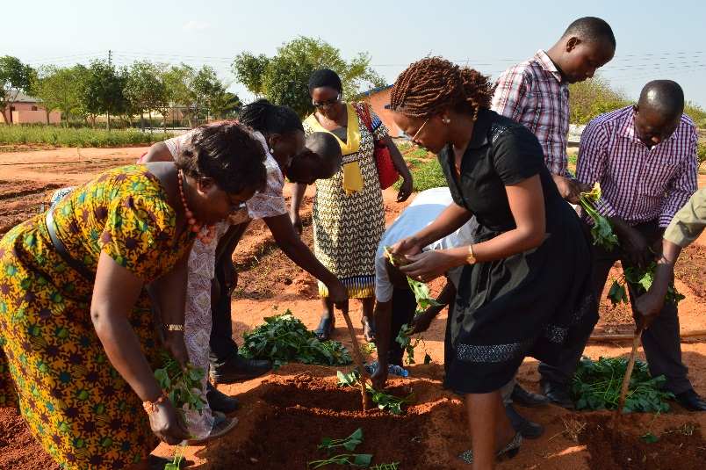
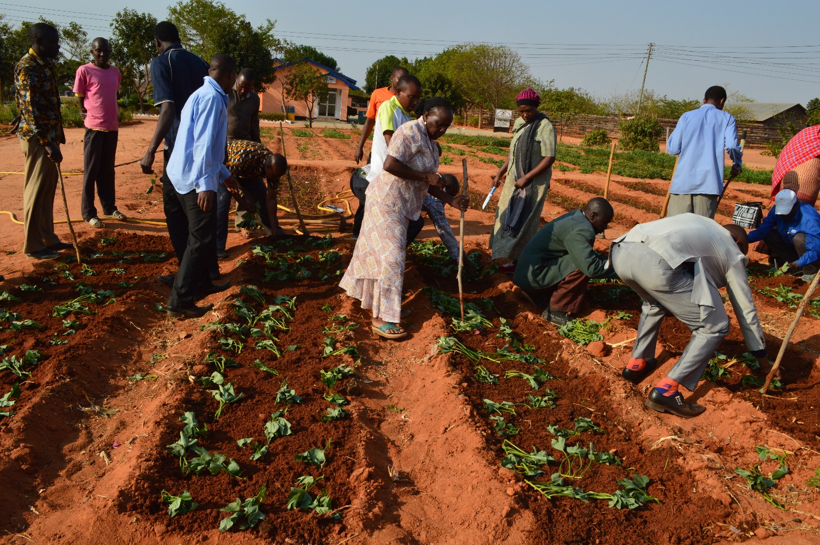
Practical session at 88 ground Dodoma

Slide 16
Activities
Sugarcane Research Institute (SRI) is fully responsible for achieving the following outputs:
Engage at least one commercial processor to process OFSP related products.
SRI is establishing collaboration with Matoborwa company based in Dodoma – in linking sweetpotato farmers to processing factory; selection and introduction of suitable varieties is in progress and storage trials will also be done at Hombolo

Slide 17
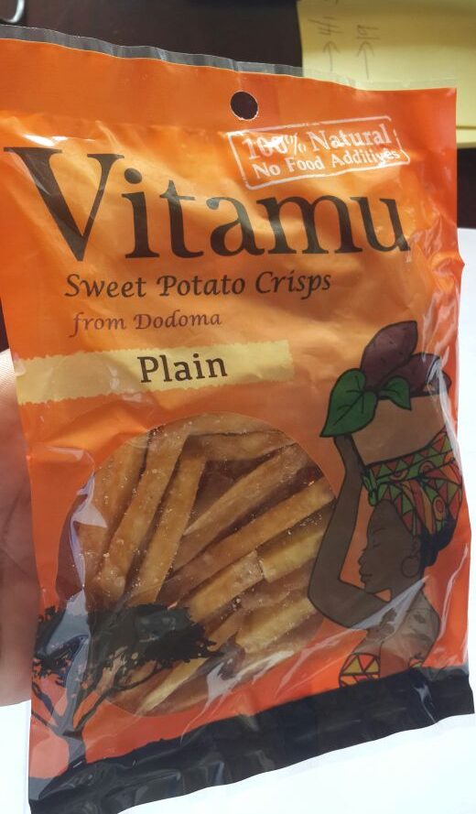
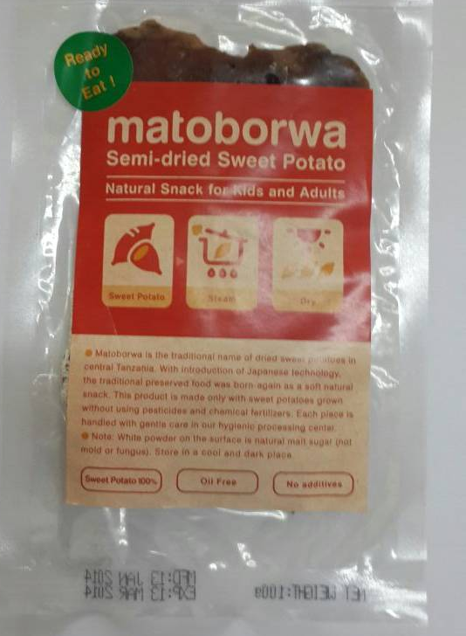
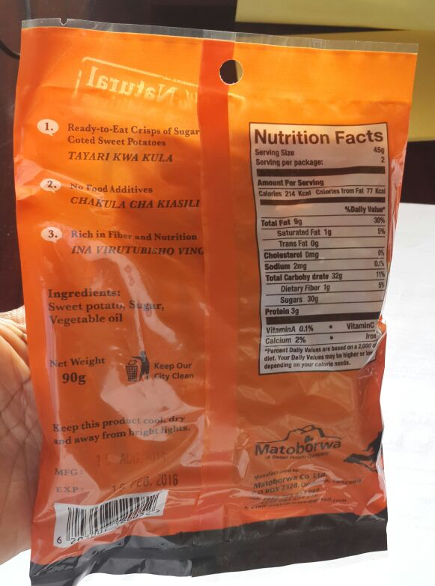
Processed products: Matoborwa and Vitamu
Matoborwa Company in Dodoma, central Tanzania

Slide 18
Activities
Release committee of Tanzania engaged to fast-track the release of at least 2 OFSP varieties and bio-fortification included as a key criteria/element (special trait) for release of sweetpotato in Tanzania. Already taken on board for OFSP as beta-carotene content has to be one of the data reported.
SRI selected 9 varieties for fast tracking the official release: The breeding lines include: SPKBH 06/266; NASPOT 13; SPKBH 06/676; NASPOT 9; G40_02; SPKBH 03/03; ex-luambano and Ejumula. Kabode- released in Sept 2016. Data collection is in progress in collaboration with VISTA project.

Slide 19
Activities
Other Activities:
SRI participated in 88 agricultural show to show case OFSP varieties
SRI-Kibaha, ARI-Hombolo and CIP particpated in launching a 4 years program that will ensure each household in Ilindi village grow OFSP. The Program was inaugurated by Ilindi councilor Ms Tina Mbassa. We consider Ms Tina Mbassa as one of the advocates in Dodoma

Slide 20
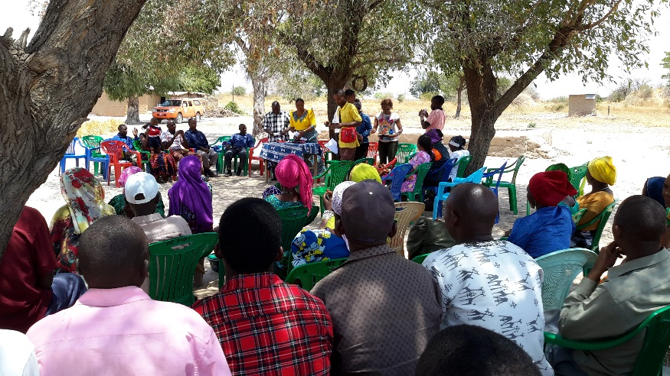
Illindi Village –Launch of 4 years OFSP plan

Slide 21
Challenges
Dry weather, delayed on-set of the rains in the central zone (Dodoma, Singida), could be a challenge to multipliers
High demand of OFSP seeds

Slide 22
Lessons learned
We experience RAC I trickle down effects-investment from Phase 1
Variety Ejumula is doing well in Dodoma- a low incidence area

Slide 23
Workplan
 | Dec | Jan | Feb | Mar | Apr | May | Jun | Jul | Aug | Sep | Oct | Nov
Pre-basic seed multiplication
Training of lead farmers
Dissemination of vines
Follow-up of seed multiplication
Initiate link farmers-processors

Slide 24









Thank you for your attention!

