Slide 1
DNA profiling of sweetpotato cultivars and clones
GT4SP Capacity building & Training
WEBINAR 30th November 2016
Time 11.00-12.30
Mercy Kitavi

Slide 2
Genetic markers
  Traits; Drought tolerance,
  Yield, SPVD resistance
  Β carotene
  Phenotype
Genes responsible
Molecular markers
Visual markers
SSRs, AFLP, SNPs

Slide 3
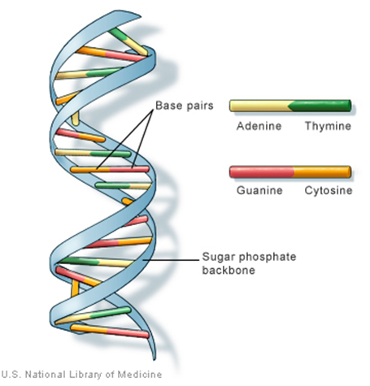
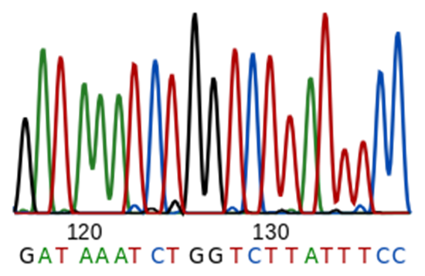
DNA profiling
DNA testing, DNA typing, genetic fingerprinting
Majority of DNA is the same for organisms in the same species but there are pieces, regions/patterns that differ within the species
Knowing these DNA sequences is the basis of DNA profiling
DNA sequencing; determining the nucleotide sequence of a given DNA fragment

Slide 4
DNA profiling
DNA testing, DNA typing, genetic fingerprinting
Distinguishing between individuals of the same species using samples of their DNA
DNA testing, DNA typing, genetic fingerprinting
DNA testing, DNA typing, genetic fingerprinting
DNA testing, DNA typing, genetic fingerprinting
DNA testing, DNA typing, genetic fingerprinting
DNA testing, DNA typing, genetic fingerprinting

Slide 5
Simple sequence repeats
Repeated variable sequences in the DNA fragment
Developed from expressed sequence tags in the genome –fingerprinting
For MAS a sequence is either near or in a gene of interest
Codominant- distinguish homozygote from heterozygote
  this is lost when data is converted into binary
Locus specific
PCR based
Tiny DNA amount needed
GTACAAGATATATATATATCTATCCGACA….
di-nucleotide repeat
GTACTAGACTACTACTACTACTCTGGTG……
Tri-nucleotide repeat
GTACAAGATCGATCGATCGATCTGGGTAC.. Tetra-nucleotide repeat
Penta, hexa etc

Slide 6
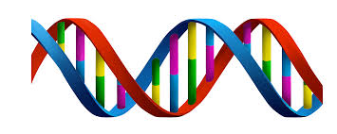
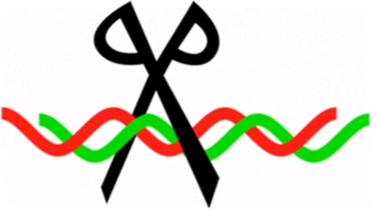
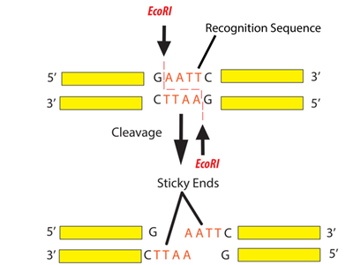
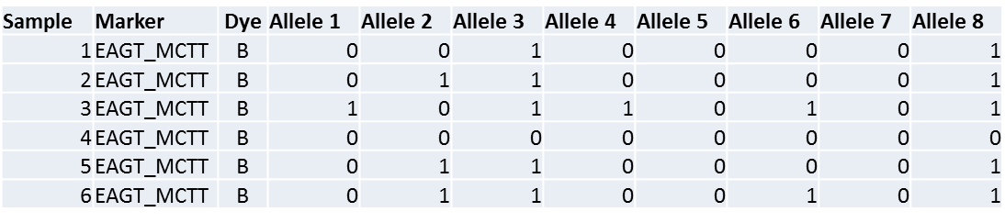
Amplified Fragment Length Polymorphism (AFLP)
DNA is cut into pieces by restriction enzyme into many fragments
Frequent cutter-generate fragments 50-500bp length resolvable by gel electrophoresis
Rare cutter limit number of amplifiable amplicons
DNA
Restriction enzyme
The enzymes either recognizes the sequences in a sample and cuts (therefore you score 1) or doesn’t cut if no recognition sequence therefore you have a -0
Adaptors
Image credit; Google images

Slide 7
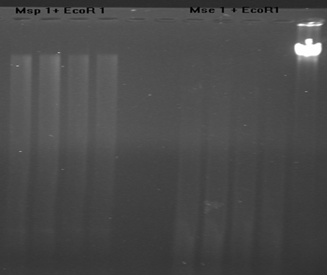
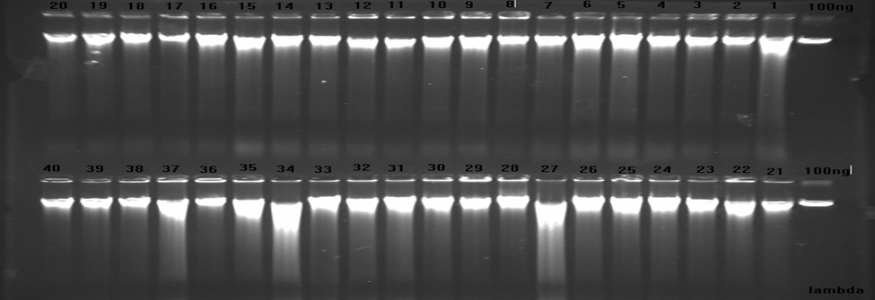
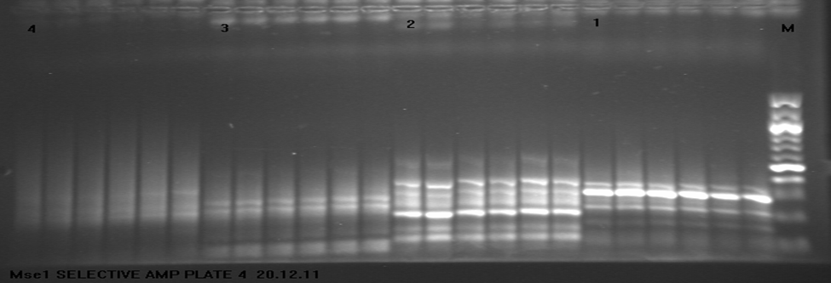
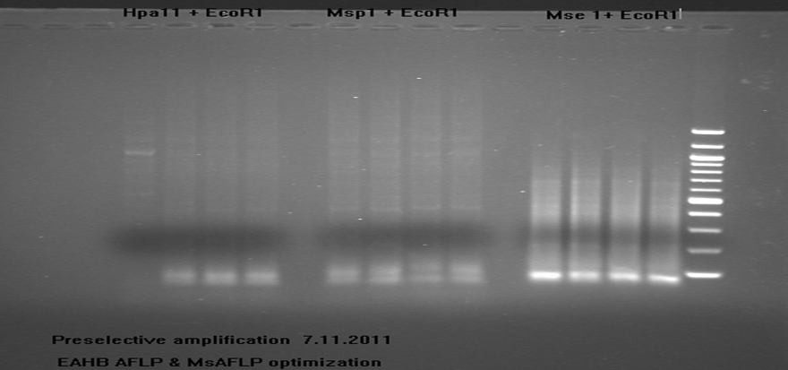
AFLP data generation flow
EcoR1
Mse1
Sequential restriction of DNA
Preselective amplification
Selective amplification
You end up with presence /absence of the fragment
Sample | Marker | Dye | Allele 1 | Allele 2 | Allele 3 | Allele 4 | Allele 5 | Allele 6 | Allele 7 | Allele 8
1 | EAGT_MCTT | B | 0 | 0 | 1 | 0 | 0 | 0 | 0 | 1
2 | EAGT_MCTT | B | 0 | 1 | 1 | 0 | 0 | 0 | 0 | 1
3 | EAGT_MCTT | B | 1 | 0 | 1 | 1 | 0 | 1 | 0 | 1
4 | EAGT_MCTT | B | 0 | 0 | 0 | 0 | 0 | 0 | 0 | 0
5 | EAGT_MCTT | B | 0 | 1 | 1 | 0 | 0 | 0 | 0 | 1
6 | EAGT_MCTT | B | 0 | 1 | 1 | 0 | 0 | 1 | 0 | 1

Slide 8
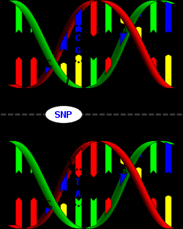
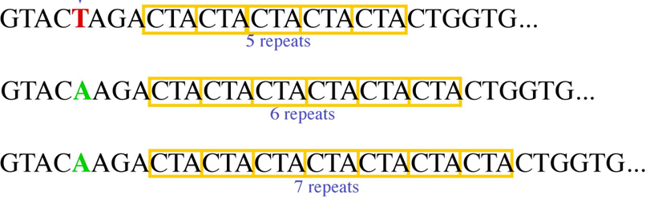
Single nucleotide polymorphism
Difference in a single DNA building block, nucleotide
SNP
Swp1
Swp2
Swp3
Images courtesy of Google

Slide 9
Use of molecular markers in plant breeding
cultivar identification
the determination of ‘hybridity’
genetic diversity assessment
genetic mapping- Zhang et al 2016
gene tagging
gene flow
molecular evolution

Slide 10
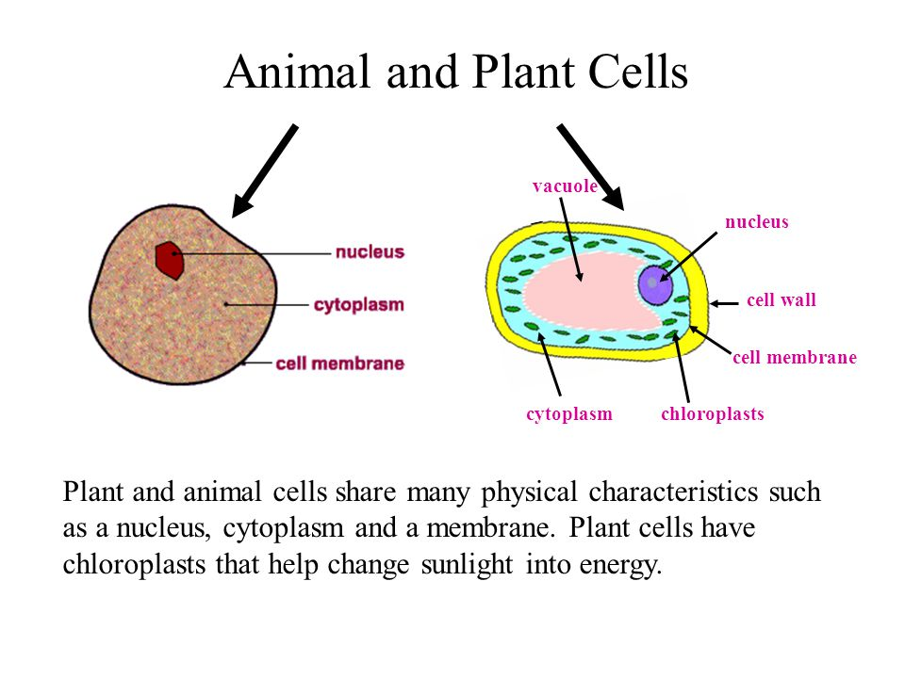
Steps

Slide 11
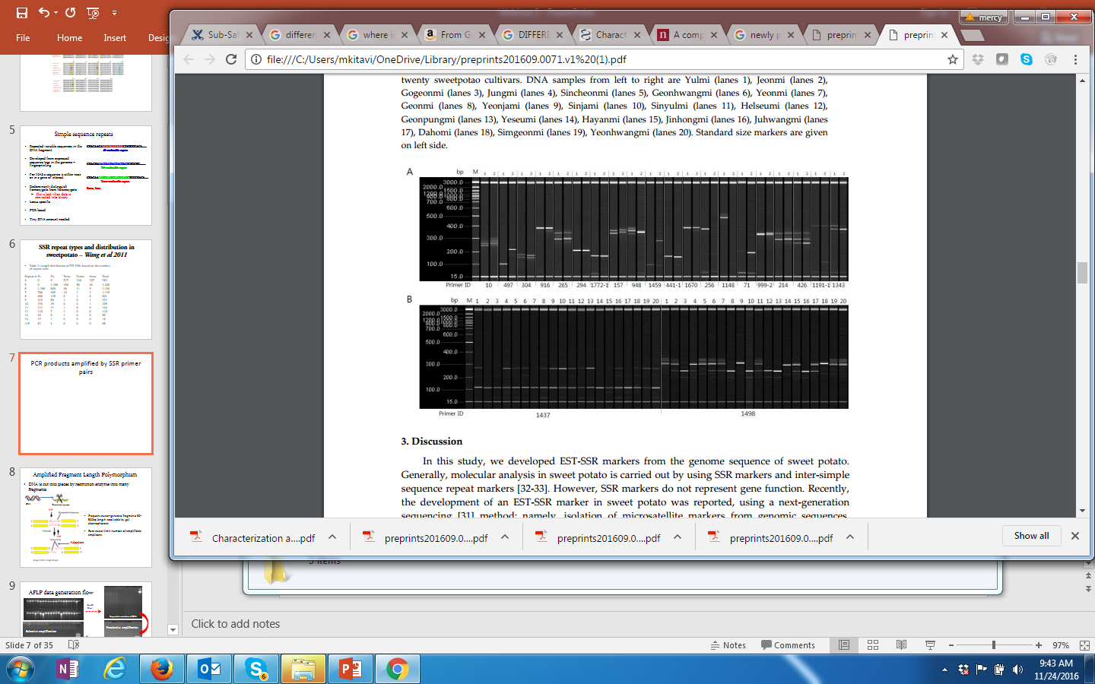
Figure 3. SSR primer pairs for Amplification of PCR products. A: PCR products amplified by 20 primer pairs from two cultivars B: PCR products amplified by 2 primer pairs from twenty sweetpotato cultivars – Zhang et al 2016
Fragment analysis on gel systems
Polymorphism
No amplification
Un amplified DNA
PCR products
Primer dimer

Slide 12
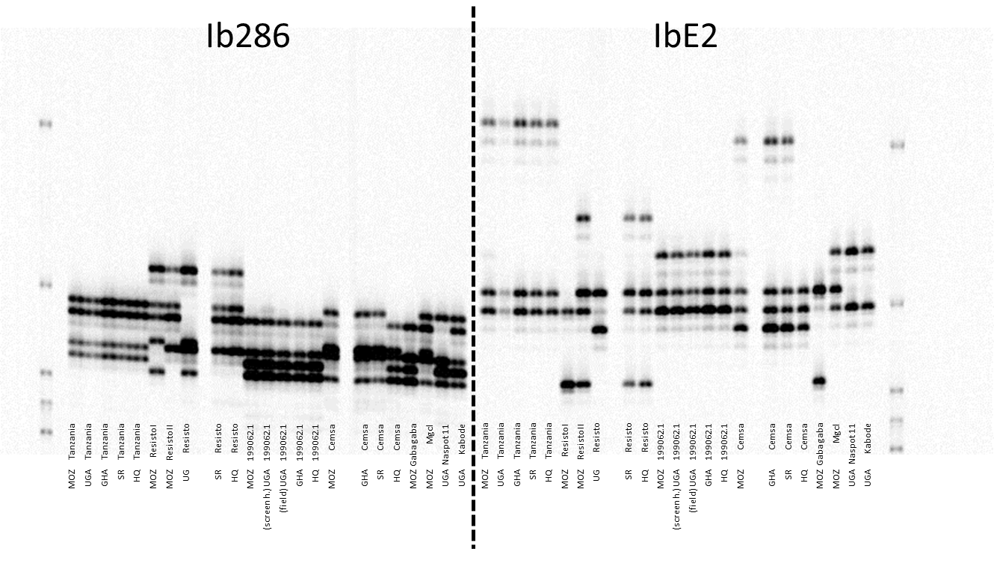
Polyacryamide gels- PAGE & LICOR
Gel images from the LiCOR IR2
M
500bp
300bp
200bp
150bp
100bp

Slide 13
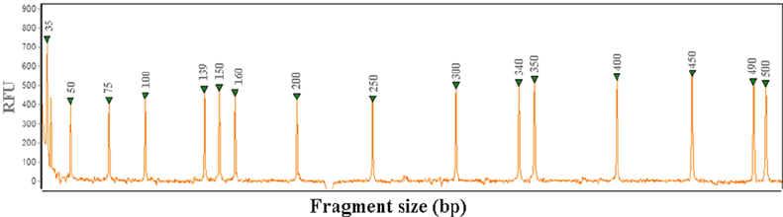
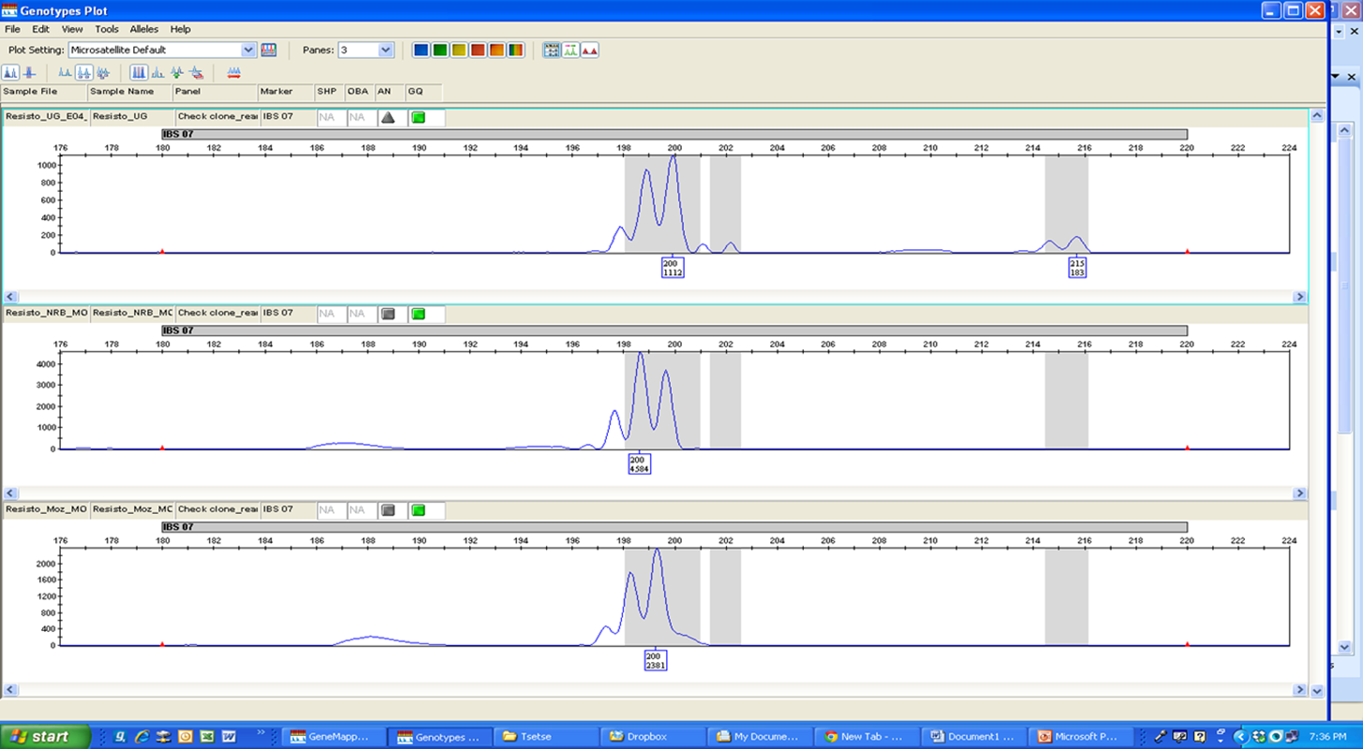
Capillary fragment analysis
Allele 1
Allele 2
Locus

Slide 14
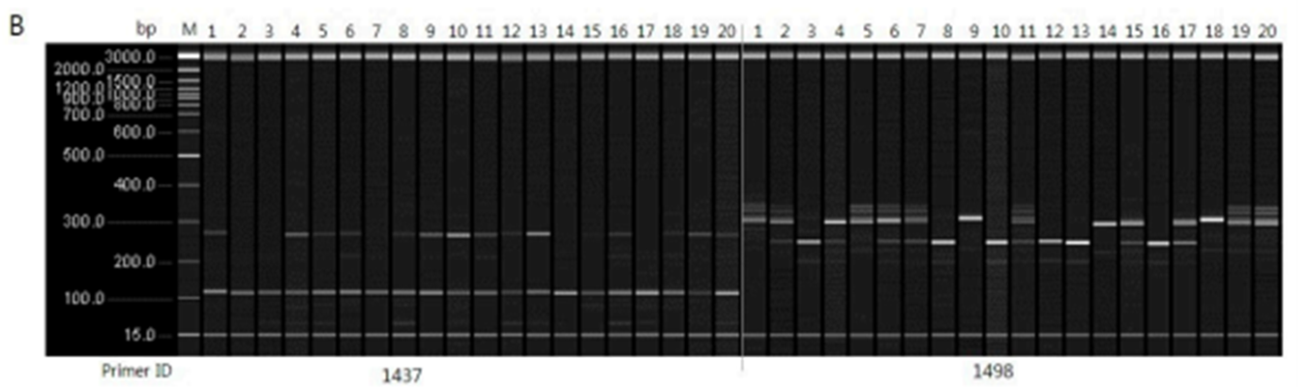
Generating data/scoring alleles on gel

Slide 15
Convert SSR basepairs data file into binary format either manually, excel or using ALS Binary software
Marker 1- Allele data
Marker 1- binary format data

Slide 16
Phylogeny and clone identification with DARwin
Steps
Prepare your genetic data files in excel (SSR, AFLP, RAPDs)
Format your data into a .VAR and .Don files
  .VAR file- markers as columns & rows as genotypes
  .Don file has genotype information e.g. genotype names, country of origin, place of collection etc
Save files as a tab delimited files e.g edited_Webinar_2.var & webinar_2.Don

Slide 17
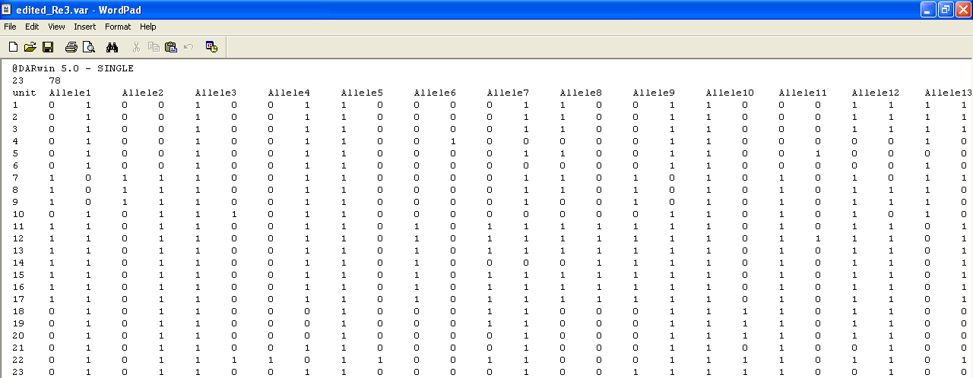
Data analysis with DARwin
No. of alleles/
fragments
No. of genotypes

Slide 18

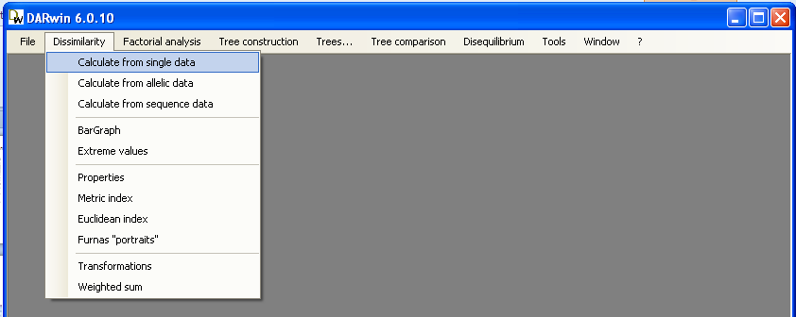
DARwin- Dissimilatity analysis and Representation
DARwin is a software package developed for diversity and phylogenetic analysis on the basis of evolutionary dissimilarities
DARwin 6 is an update of version 5 may have bugs and fail to work in some computers; DARwin 5 works well
1
Double click icon
2-single click
3- single click

Slide 19
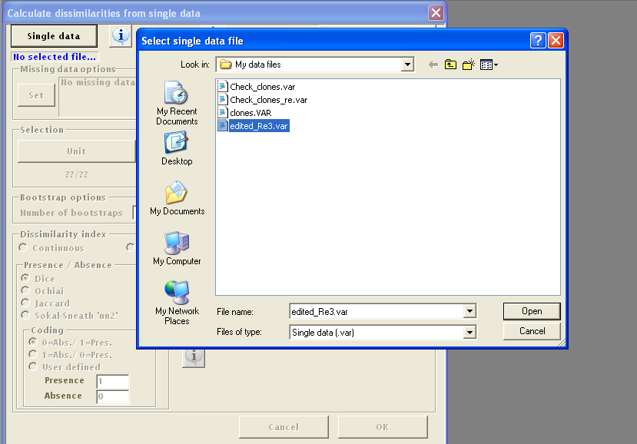
Choose your .var file
4
Click
5

Slide 20
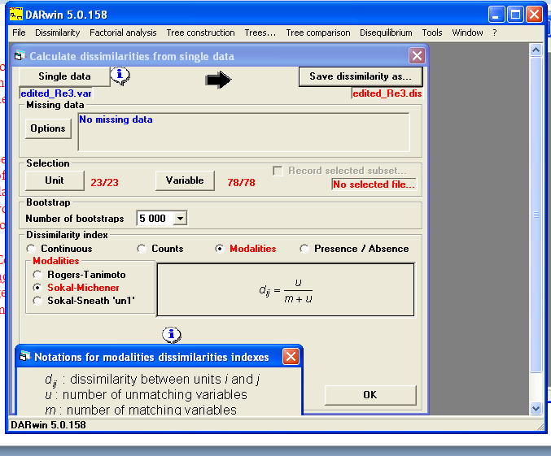
Unit = no of samples/genotypes
variable = total alleles of all markers combined
Save your calculated dissimilarity file
Automatically saves as a .dis file
Your imported file
Set the % of missing data that you want to allow
How many times you want your analysis repeated
Choose the dissimilarity index
Click here to see the explanation of chosen dissimilarity formula
Click here after all settings

Slide 21
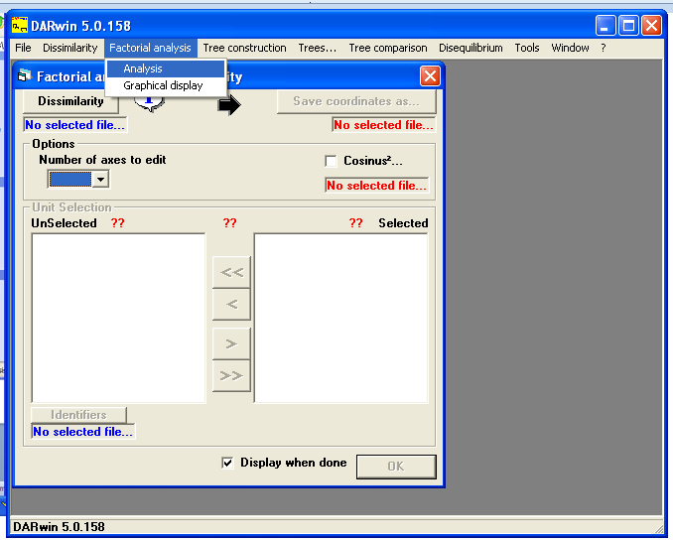
Click here

Slide 22
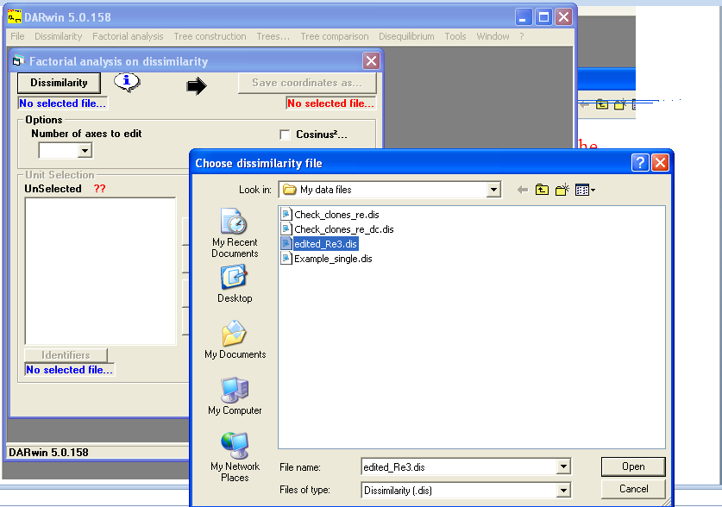
Choose the dissimilarity file you saved
Click here

Slide 23
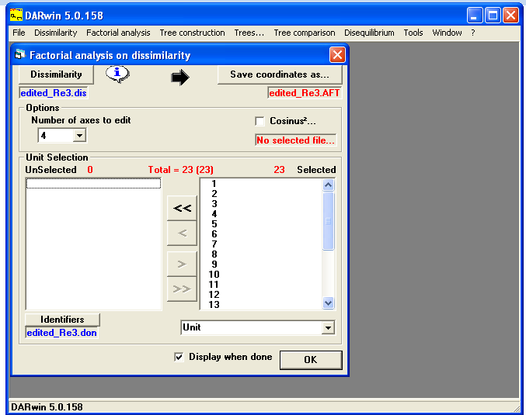
Properties of the current file
Dissimilarity file used for PCA construction
Click here to save coordinate file. saves automatically as a .AFT
No. of coordinates the PCA will be represented
Choose the identifier file, the .don file that you prepared with the .var
Click here last

Slide 24
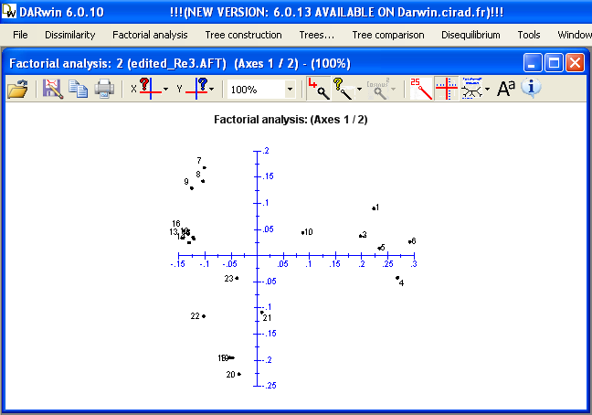
Label clones, genotypes, country etc with different colours
Click the ? To choose your identifier file and the arrow to choose how you want your genotypes identified
Axis Eigenvalue Inertia%
1 0.02259 46.51
2 0.01061 21.83
3 0.00511 10.52
4 0.00262 5.39
5 0.00246 5.06
Eigen values gives significance to the distribution of your samples on the Axes chosen

Slide 25
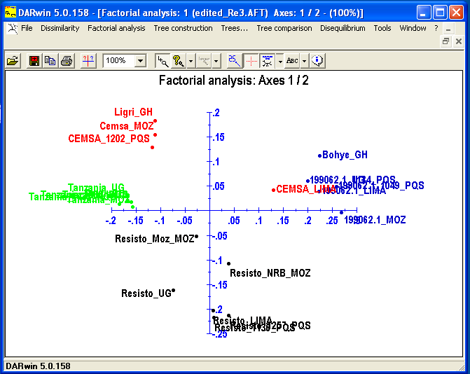
Choose font type of labels
Save the PCA
Print
Increase or decrease font of labels
Read eigen values
Copy the PCA
A PCA show variation of the samples in question when displayed on the axes
Resisto clones show the most variation
Change the display

Slide 26
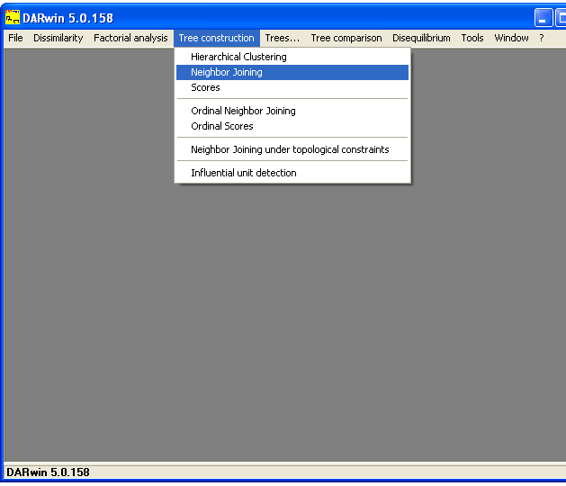
Construct the phylogenetic tree using the dissimilarity file
Click here
Choose
Neighbor joining is a bottom-up (agglomerative) clustering method for the creation of phylogenetic trees, created by Naruya Saitou and Masatoshi Nei in 1987 Usually used for trees based on DNA or protein sequence data, the algorithm requires knowledge of the distance between each pair of taxa (e.g., species or sequences) to form the tree

Slide 27
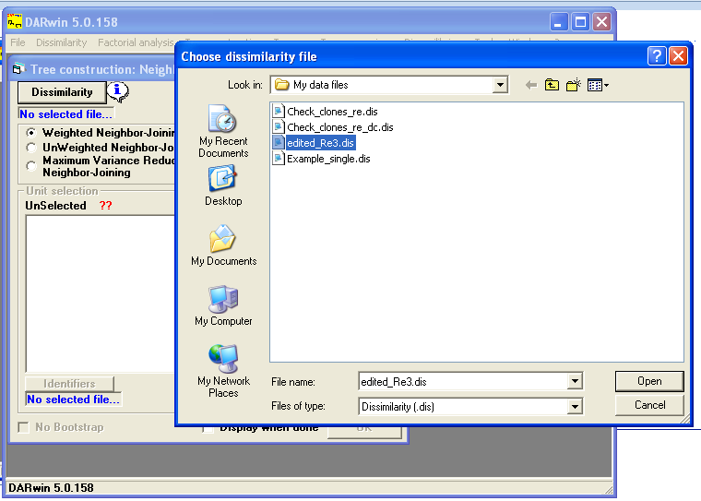
Choose the Dissimilarity file
Click

Slide 28
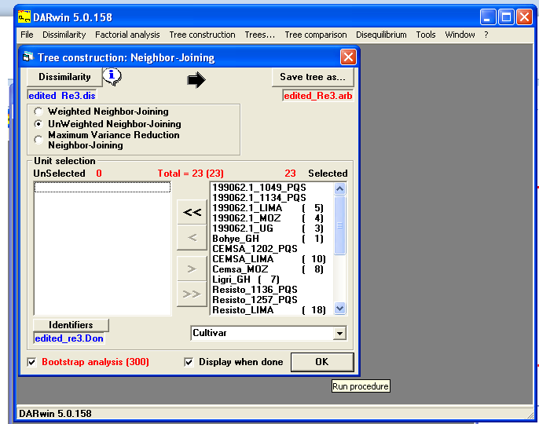
Click
Automatically saves tree as a.arb
.dis file
Alogarithim
Info file
Last click
Check box
Check box

Slide 29
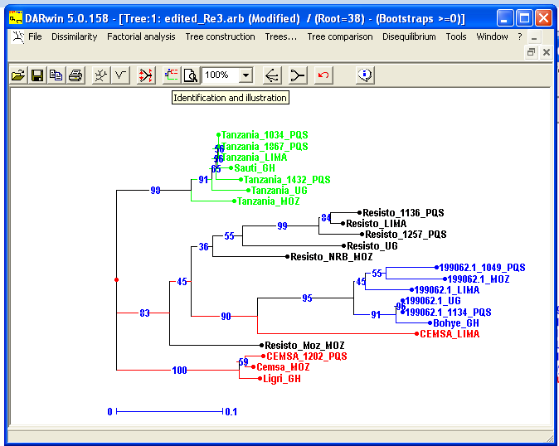
Click here for more tree edits/inputs
Change tree display to radial/axial etc
No. on branches are bootstrap values
Confidence levels of the clusters
root
Scale

Slide 30
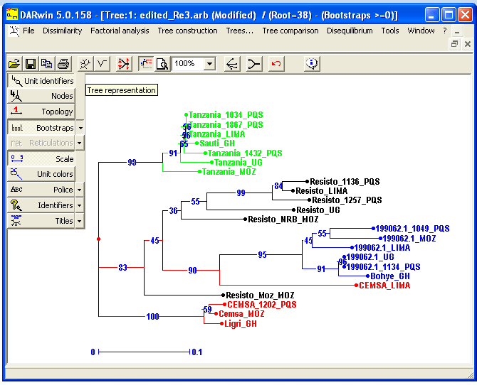
Choose bootstrap values displayed
Turn off/on the scale
Colour labels
Font type and size

Slide 31
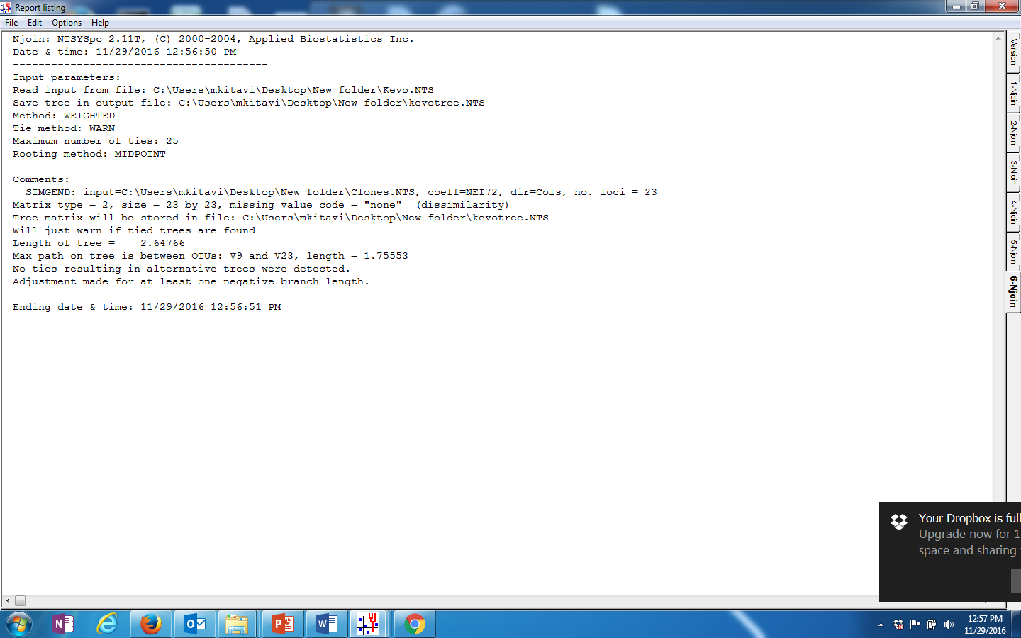

Slide 32
Njoin: NTSYSpc 2.11T, (C) 2000-2004, Applied Biostatistics Inc.
Date & time: 11/29/2016 12:56:50 PM
----------------------------------------
Input parameters:
Read input from file: C:\Users\mkitavi\Desktop\New folder\Kevo.NTS
Save tree in output file: C:\Users\mkitavi\Desktop\New folder\kevotree.NTS
Method: WEIGHTED
Tie method: WARN
Maximum number of ties: 25
Rooting method: MIDPOINT
Comments:
SIMGEND: input=C:\Users\mkitavi\Desktop\New folder\Clones.NTS, coeff=NEI72, dir=Cols, no. loci = 23
Matrix type = 2, size = 23 by 23, missing value code = "none" (dissimilarity)
Tree matrix will be stored in file: C:\Users\mkitavi\Desktop\New folder\kevotree.NTS
Will just warn if tied trees are found
Length of tree = 2.64766
Max path on tree is between OTUs: V9 and V23, length = 1.75553
No ties resulting in alternative trees were detected.
Adjustment made for at least one negative branch length.
Ending date & time: 11/29/2016 12:56:51 PM

Slide 33
Tree interpretation
Clustering method; unweighted-pair group method with arithmetic means
(UPGMA)
use a sequential clustering algorithm.
A tree is built in a stepwise manner, by grouping allele phenotypes /sequences /or groups of sequences– usually referred to as operational taxonomic units (OTUs)– that are most similar to each other; that is, for which the genetic distance is the smallest.
When two OTUs are grouped, they are treated as a new single OTU
From the new group of OTUs, the pair for which the similarity is highest
is again identified, and so on, until only two OTUs are left (the most distance)
Clones in the same cluster have high similarity based on the SSR allele phenotypes
Clones clustered on the same position vertically; are clones (have zero dissimilarity)
Tanzania-1867,1034 & LIMA
199062.1-UG & 1134-PQS

