Slide 1
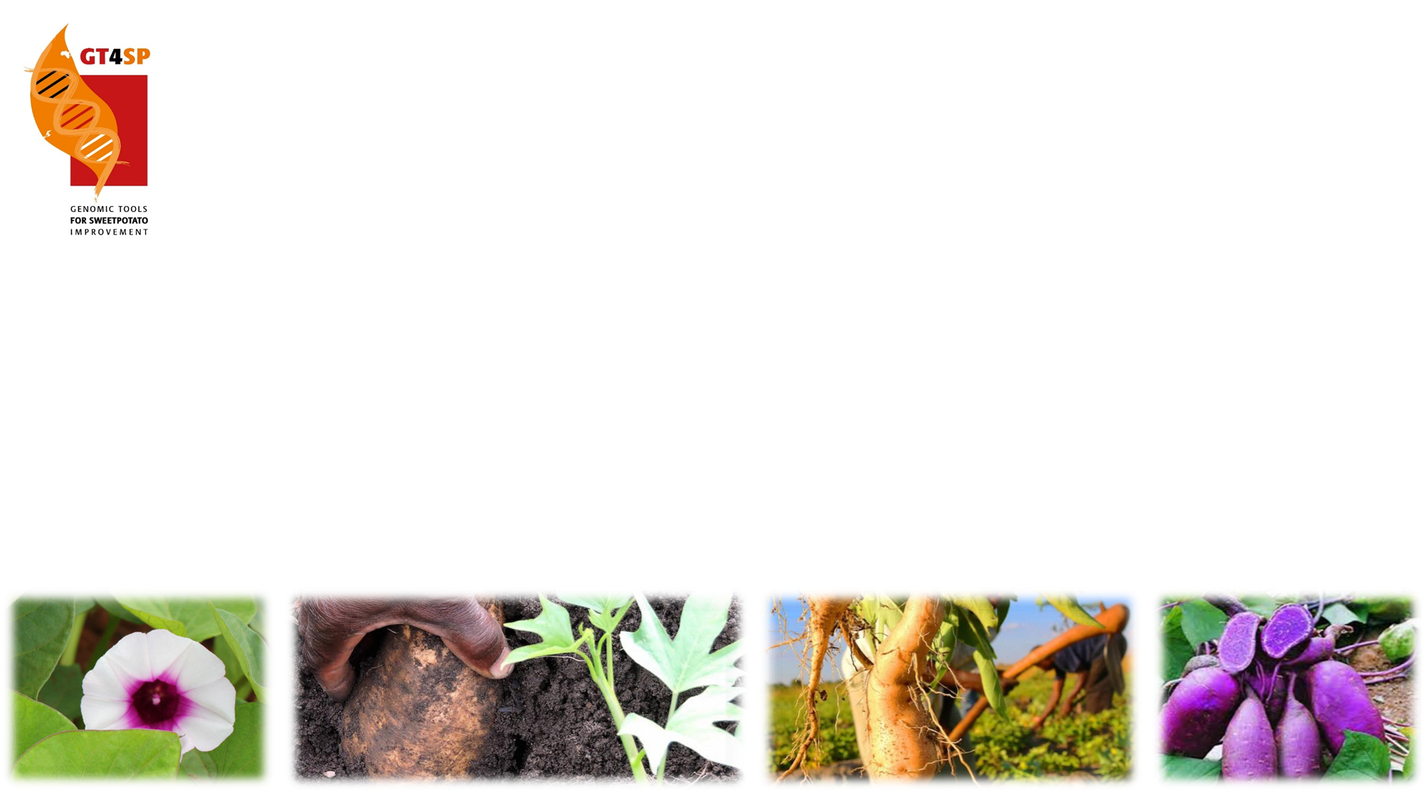

Panning the Gold:
QTL mapping and Genomic Selection in Hexaploid Sweetpotato
Bode Olukolu and Craig Yencho (NCSU)
Dorcus Gemenet, Mercy Kitavi and Marc Ghislain (CIP)

Slide 2
Outline
Markers and Next-Generation Genotyping Platforms
Marker-Assisted Selection (MAS) for Sweetpotato Improvement
Linkage, QTL and Genome-Wide Association Analysis
Genomic Selection (GS)
Suggested Discussion points

Slide 3
Outline
Markers and Next-Generation Genotyping Platforms
Marker-Assisted Selection (MAS) for Sweetpotato Improvement
Linkage, QTL and Genome-Wide Association Analysis
Genomic Selection (GS)
Suggested Discussion points

Slide 4
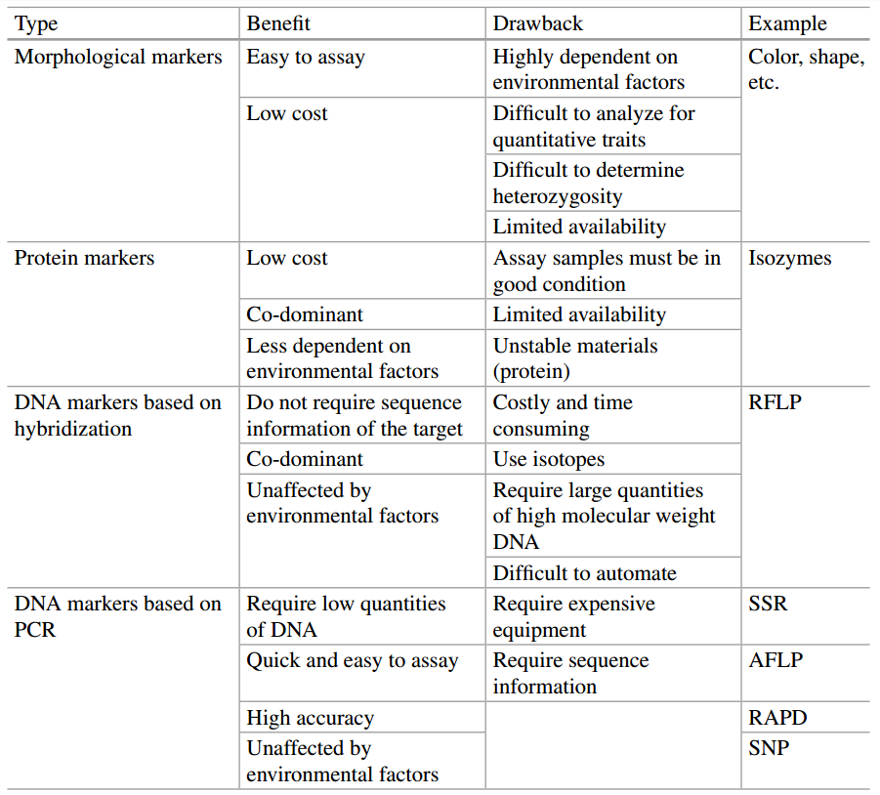
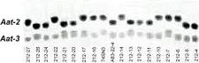
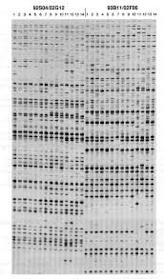
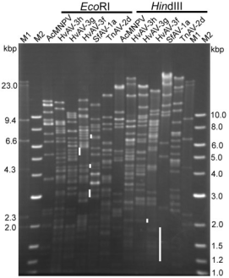
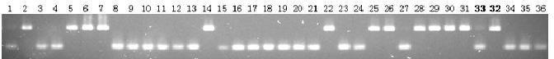
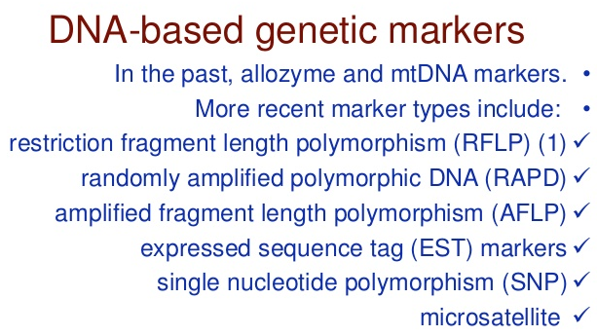
Genetic Markers
AFLP
Isozymes
RFLP
SSR

Slide 5
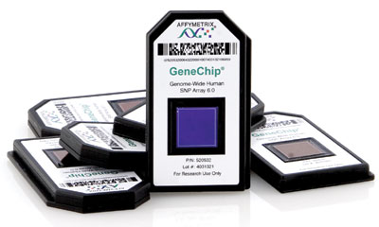
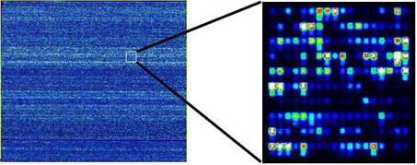


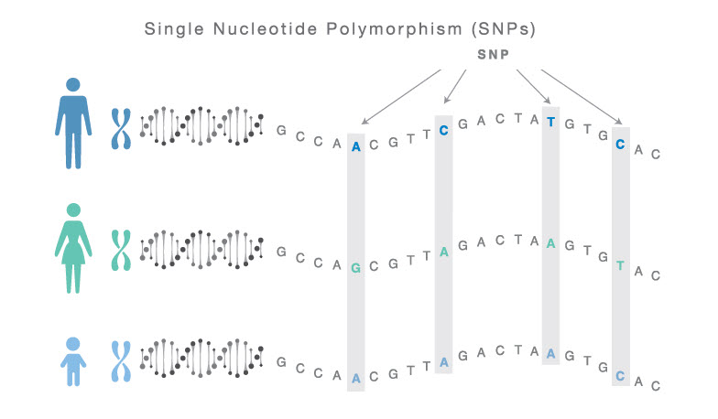

Next-Generation Genotyping: SNP Arrays
Affymetrix chip
Illumina chip
Single Nucleotide Polymorphism (SNP)
SNPs are much more common in genome
Usually 2 alleles and maximum of 4 alleles

Slide 6
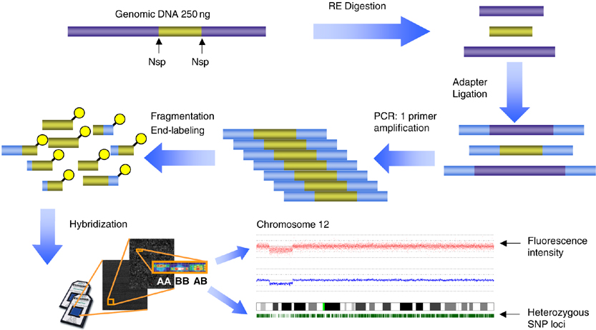
SNP chip/array
- Hybridization of fragmented single-stranded DNA to arrays.
- Contains thousands to hundreds of thousands of unique DNA sequences.
- Single intensity depends on amount of target DNA in sample.
- Manufacturers report genotyping accuracy of 99.5% in diploid genomes.
- approx. $30 per sample (10-20 thousand SNPS)

Slide 7
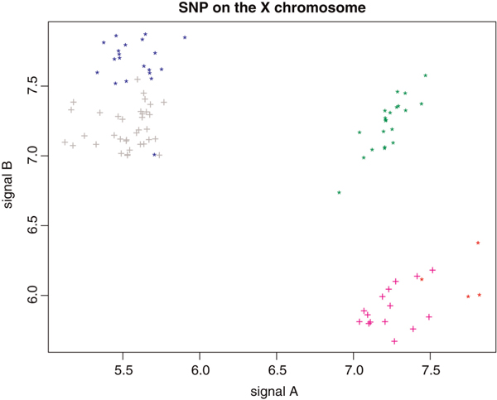
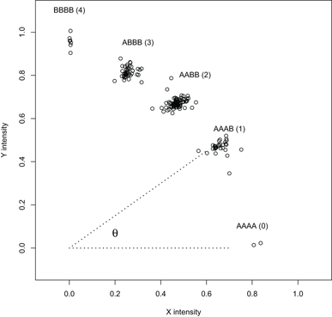
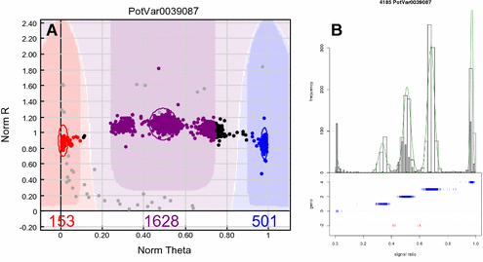
SNP Calling Algorithms
Affymetrix GeneChip array. Normalised and summarized allele intensity
Clustercall (R-package)
Illumina GenCall algorithm (Bead studio application)
FitTetra
(R-package)

Slide 8
SNP Array: Pros and Cons
Pros
Less bioinformatic analysis
Few missing data (Optimized GBS protocol now achieves this)
Easy to perform
Cheap (GBS now getting cheaper)
Cons
Takes time to design an array and initial cost is expensive
Ascertainment bias: SNPs discovered in a small set of samples (resolvable)
Unreliable genotype call in highly divergent samples due to reduced probe-sequence hybridization (resolvable using GBS)

Slide 9
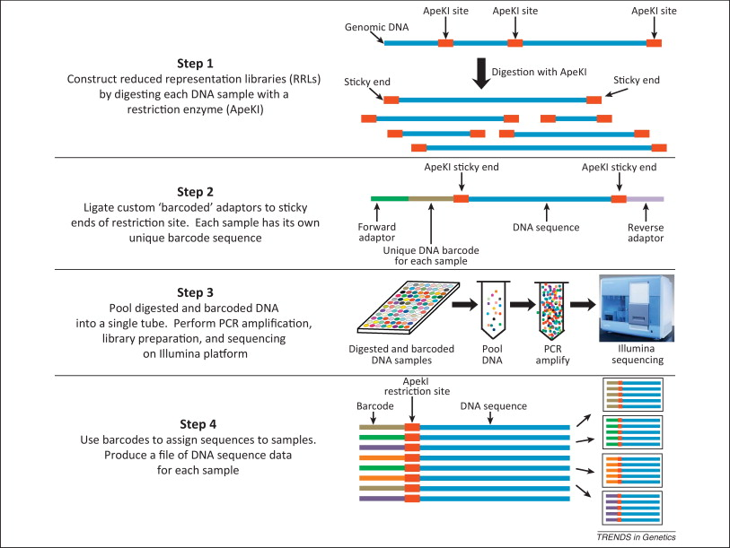
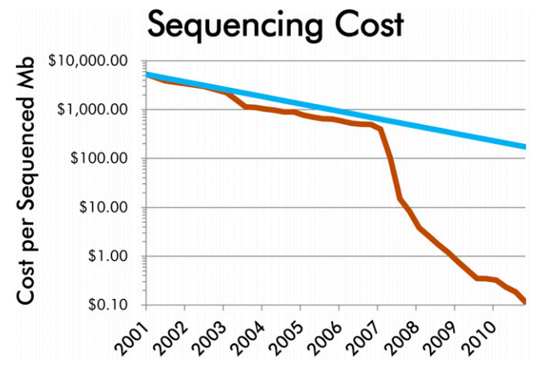
Next-Generation Genotyping:
Sequencing-based Genotyping
RAD-seq: Restriction site Associated DNA (RAD) markers
ddRAD-seq: double digest RAD-seq
DArTseq: Diversity-Array technology sequencing
GBS: Genotyping-By-Sequencing
GGRS: Genotyping by Genome Reducing and Sequencing

Slide 10
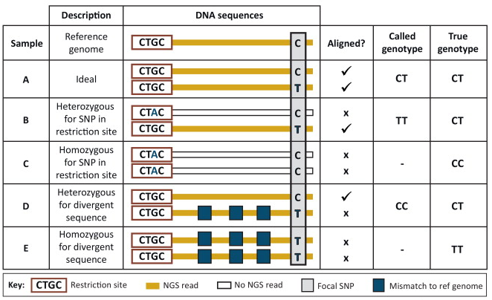
Considerations for SNP calling

Slide 11
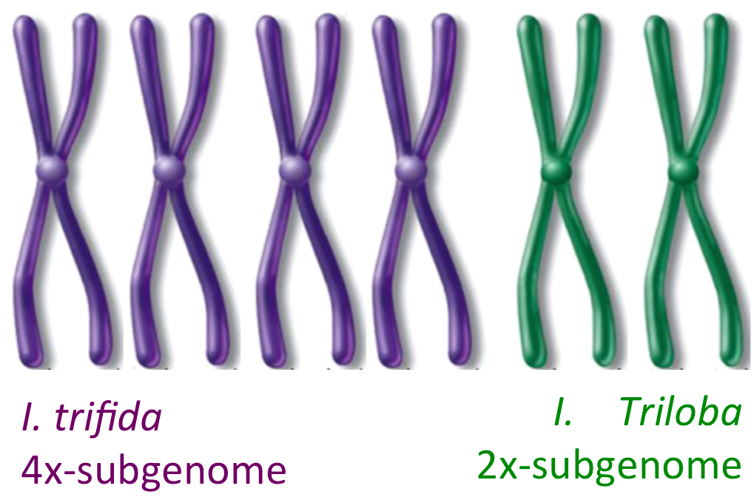
SNP calling pipeline: FastQ to Annotated SNPs
Pipeline Overview
1) Align
2) SNP call
3) Filter
Prepare reference genome:
1) Generate Fasta file index
SAM FORMAT
Create realignment targets
Extract genotypes and read depth/coverage
Reference Genome Sequence
BAM FORMAT
Indel realignment
Clean/code appropriately:
Read depth threshold
Mendelian segregation
(R-software)
Mark Duplicates
Paralog Test
BWA-MEM
Add read group header
NGS reads
- Genomic
- RNA-seq
Auto-Allo-Hexaploid Sweetpotato:
1) Homeologs (6x)
2) I. trifida specific sub-genome (4x)
3) I. triloba specific sub-genome (2x)
Re-assign quality Score
GATK HaplotypeCaller
(SNPs and INDELs simultaneously)
Paralog Test
Pre-process raw sequence reads:
1) Generate plots for quality control (QC)
2) Trim low-base calls and buffer-sequence
3) De-multiplex pooled barcoded samples
4) Trim barcode sequence
Raw VCF files
Final VCF files
Marker types:
- SNP - INDEL - SSR - epiSNP
- Restriction-site polymorphism

Slide 12
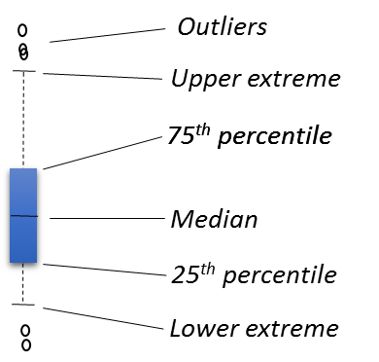
Optimized GBS protocol
-NO PCR BIAS
-MINIMAL MISSING DATA
-UNIFORM COVERAGE

Slide 13
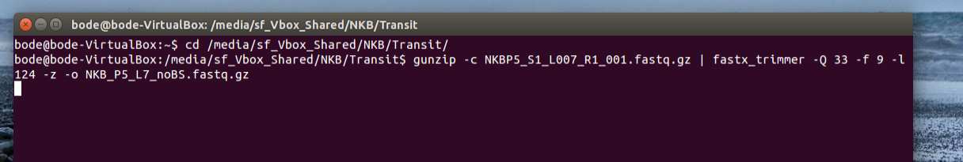
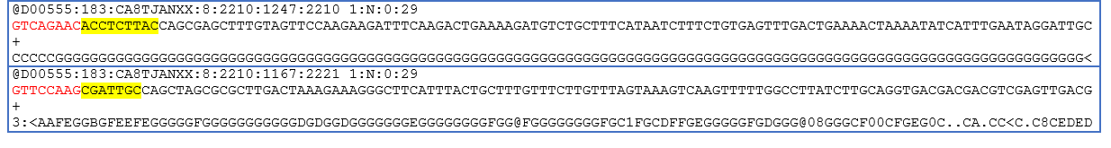
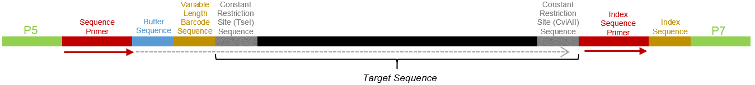
SNP calling pipeline: FastQ
BT05_285
BT05_263
CWGC (W=A or T)
TseI-cut site

Slide 14
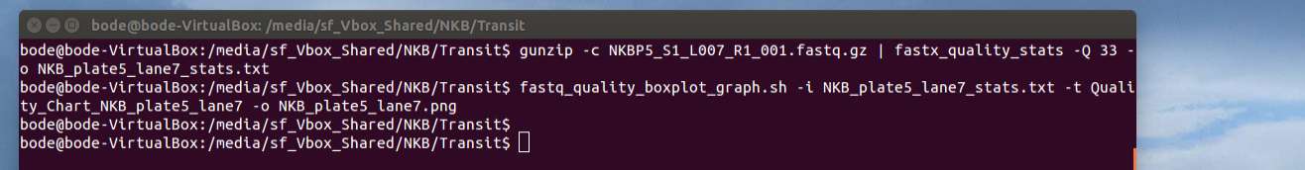
SNP calling pipeline: QC plot

Slide 15
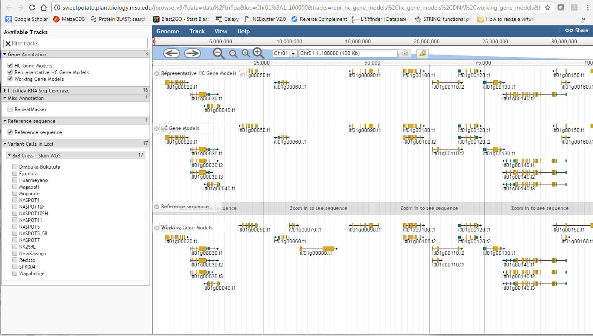
SNP calling pipeline: Alignment to reference genomes

Slide 16
SNP calling pipeline: Alignment to reference genomes
 | Hexaploid Sweetpotato (%)
De-multiplexing Accuracy (spiked with 5% Phix) | 94.12
Reads common to I. trifida and I. triloba (6x) | 89.94
Reads Specific to I. trifida (4x) | 3.71
Reads Specific to I. triloba (2x) | 3.78
Total reads aligned to reference genomes | 97.43

Slide 17
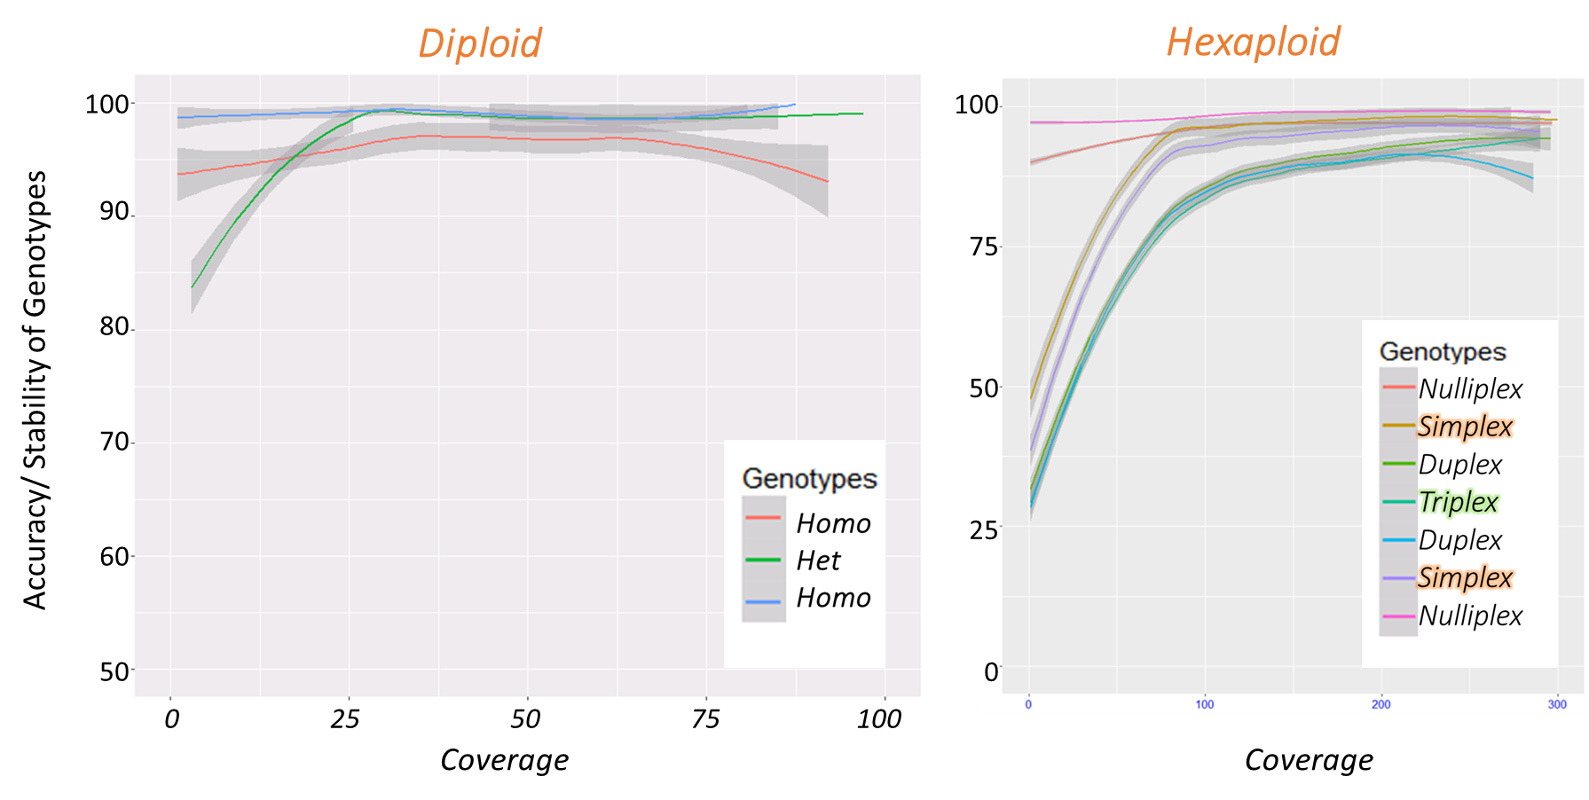
SNP calling pipeline: Unfiltered raw SNP calls

Slide 18
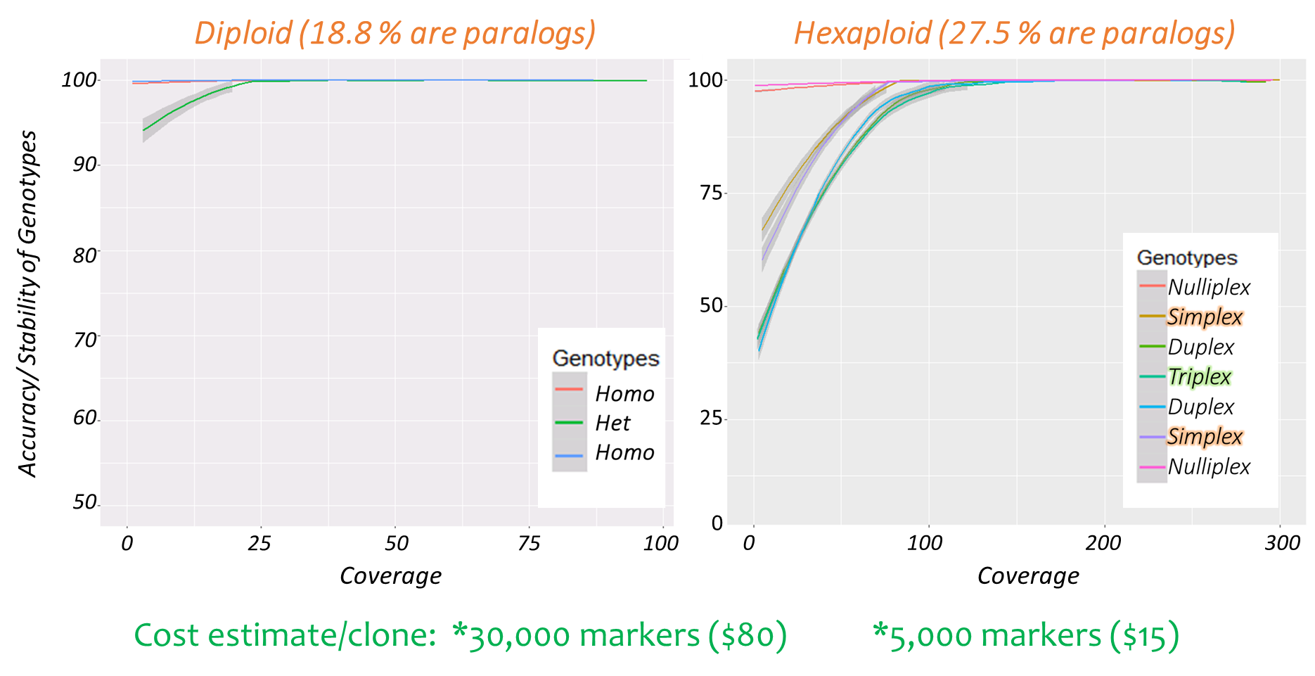
SNP calling pipeline: Filtered SNP calls

Slide 19
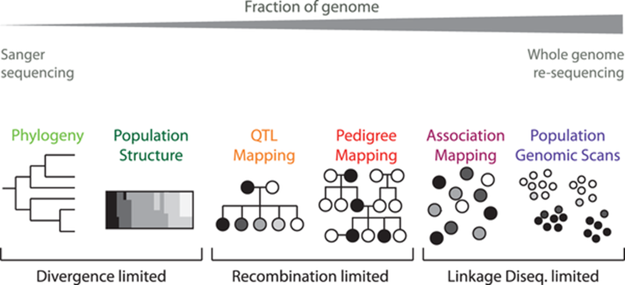
Applications and required marker density
Hwang et al. (2015) Scientific Reports.

Slide 20
Outline
Markers and Next-Generation Genotyping Platforms
Marker-Assisted Selection (MAS) for Sweetpotato Improvement
Linkage, QTL and Genome-Wide Association Analysis
Genomic Selection (GS)
Suggested Discussion points

Slide 21
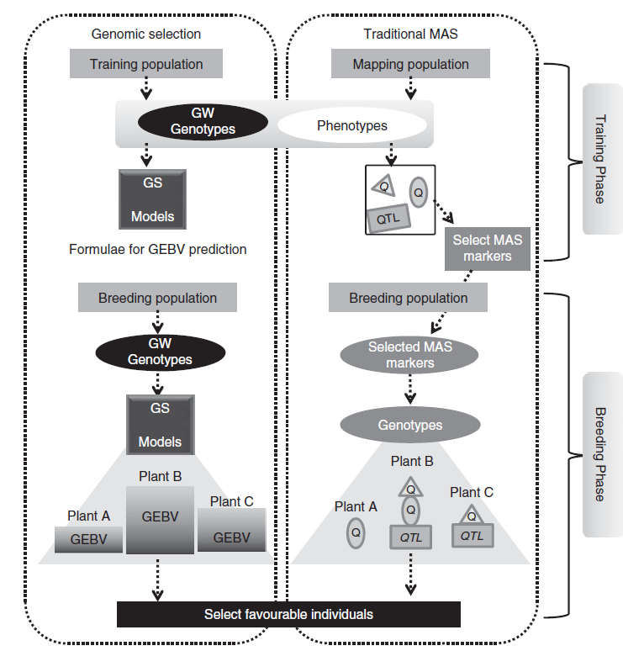
Genome-assisted breeding (GAB) in sweetpotato improvement
Divided into two: Marker assisted selection (MAS) and Genomic selection (GS)
Able to save time, resources, effort
  Faster than phenotypic selection
  selection at seedling stage
  single plant selection possible
Hence, faster genetic gains
Nakaya and Isobe, 2012

Slide 22
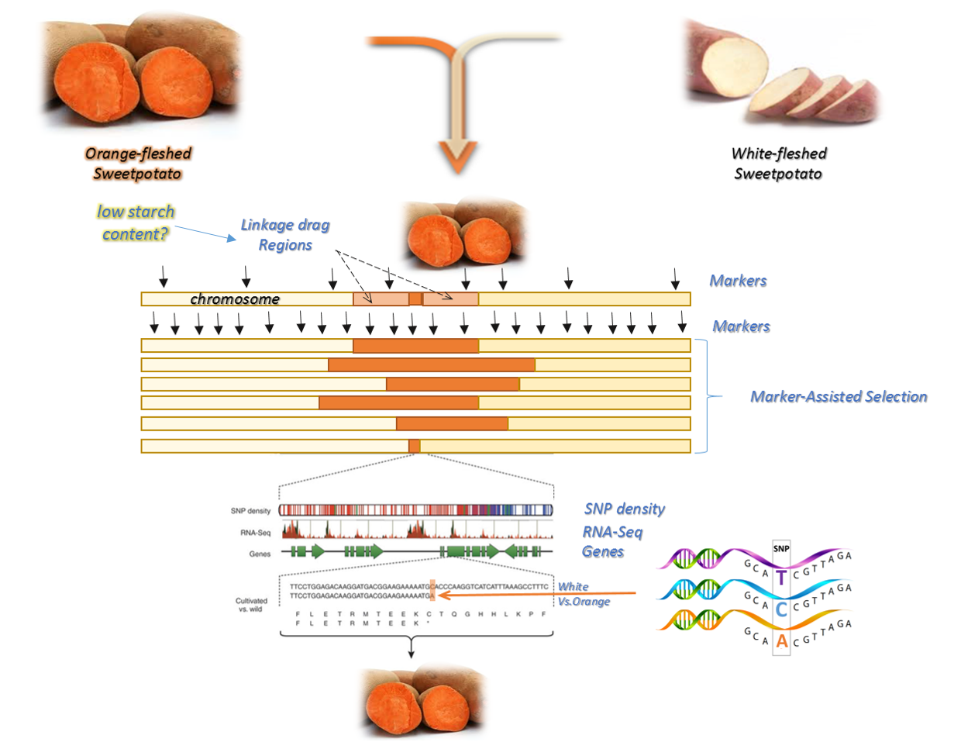
GAB I: Marker-Assisted Selection (MAS)
MAS
Involves tagging preferably one large effect quantitative trait loci (QTL)
Parental selection
  Identity, diversity, heterosis
Use QTL/markers for selecting phenotyping of interest.

Slide 23
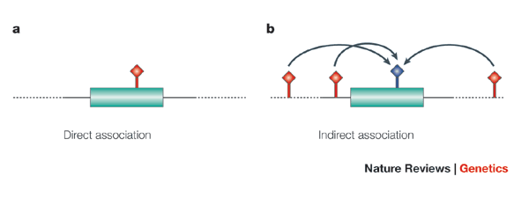
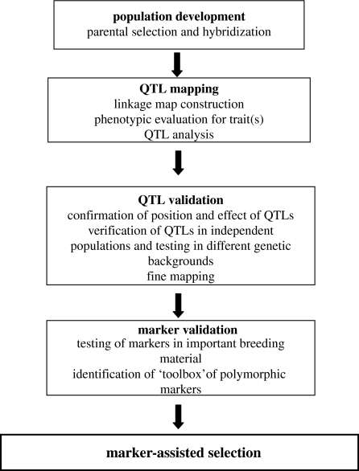
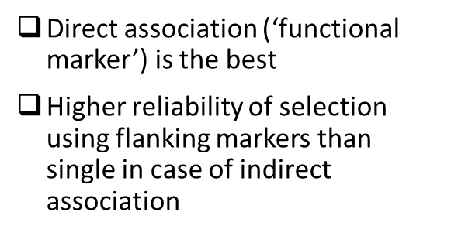
QTL Identification, Validation and Utility
Hirschhorn and Daly (2005) Nature Review.
Collard and Mackill (2008) Philos Trans R Soc Lond B Biol Sci

Slide 24
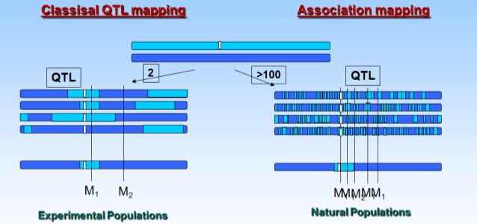
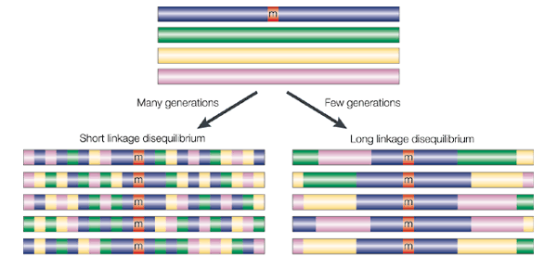
Developing populations for traditional MAS
Relies on genetic linkage
Narrow genetic base
Relies on linkage disequilibrium (LD)
Wide genetic base

Slide 25
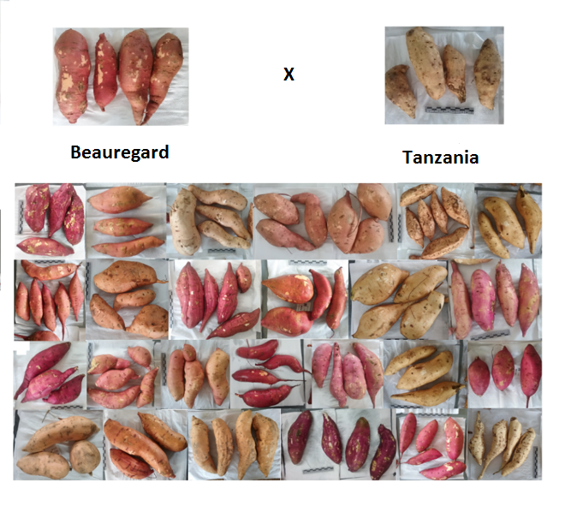
Sweetpotato populations for MAS in GT4SP Project
B x T Traits:
Beta-carotene
Dry matter
Drought
SPVD
Choosing parents for biparental mapping:
One or more contrasting trait(s)
Progenies segregating for trait(s)
Biparental for QTL mapping:
Beauregard x Tanzania (B x T; CIP)
Tanzania x Beauregard (T x B; NCSU)
New Kawogo x Beauregard (NKB: NACCRI)

Slide 26
Sweetpotato populations for MAS in GT4SP Project
Multi-parentals: Mwanga diversity panel (8x8 or B x A; CIP)
Suggests 2 different heterotic groups
Inter-group mating likely to result in high within family variation
Historical recombination preserved within design

Slide 27
Outline
Markers and Next-Generation Genotyping Platforms
Marker-Assisted Selection (MAS) for Sweetpotato Improvement
Linkage, QTL and Genome-Wide Association Analysis
Genomic Selection (GS)
Suggested Discussion points

Slide 28
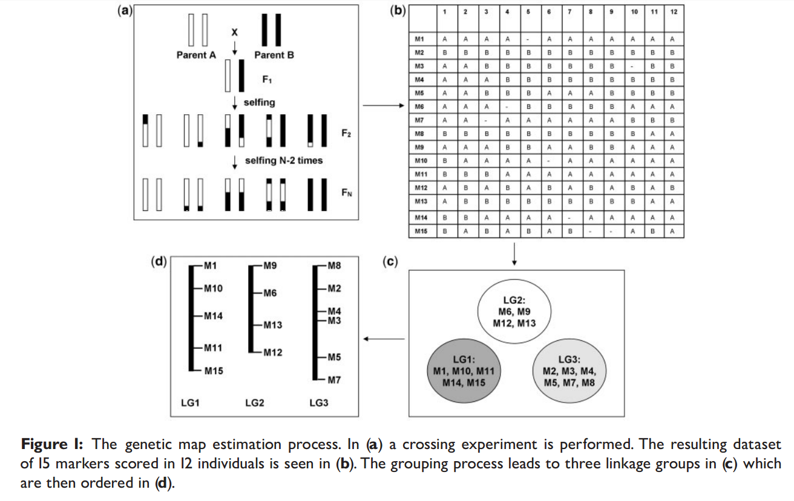
Genetic linkage analysis for QTL mapping
But for polyploid sweetpotato….
Self-incompatibility, inbreeding depression-no homozygous parents
Unavailability of good quality sequence information
Multiple alleles at marker loci and at loci for traits of interest
Different possibilities of allele dosages across homologous chromosomes
Both bivalent and multivalent pairing during meiosis
Possibility of preferential pairing of different homologs
Develop mapping population for outcrossing species
Generate large number of markers
Marker ordering and genetic distance estimation
Group markers into linkage groups. Requires input parameters specified by user.
Cheema and Dicks (2009) Briefings in Bioinformatics. 10(6):595-608

Slide 29
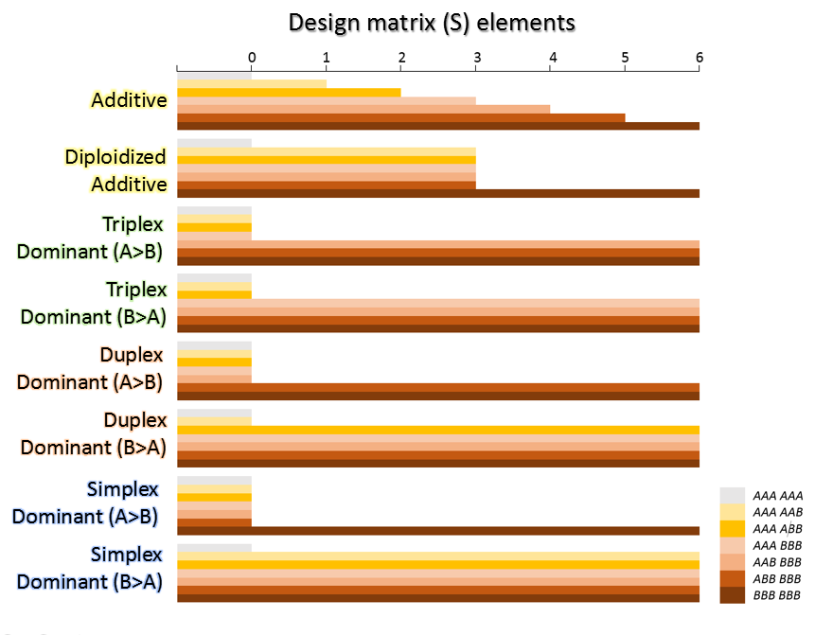
Complexity of genetic analysis in polyploids due to dosage
Does dosage matter?
An increase in copy number of all chromosomes should equally lead to increased expression in all genes (additive).

Slide 30
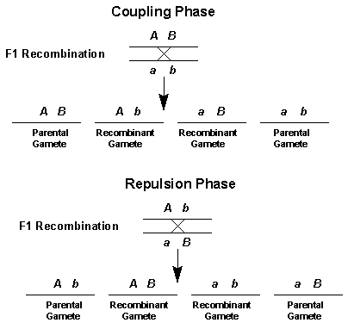
Dosage-dependent Linkage Analysis
Other considerations:
Linkage phase is a major issue in F1-populations and polyploids.

Slide 31
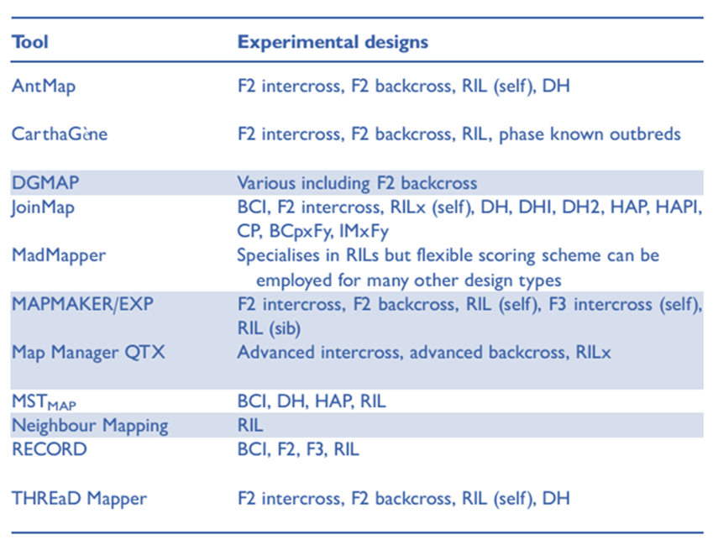
Linkage Analysis Software
Linkage mapping softwares:
Tetraploidmap®
Pergola®
PolyMap®
Cheema and Dicks (2009) Briefings in Bioinformatics. 10(6):595-608

Slide 32
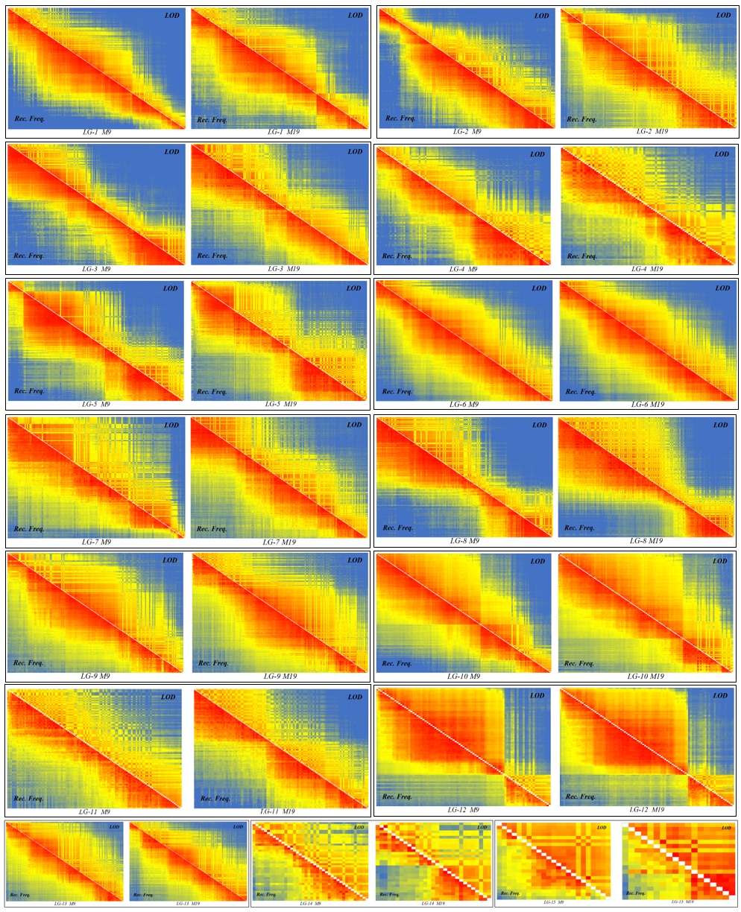
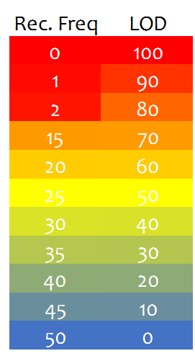
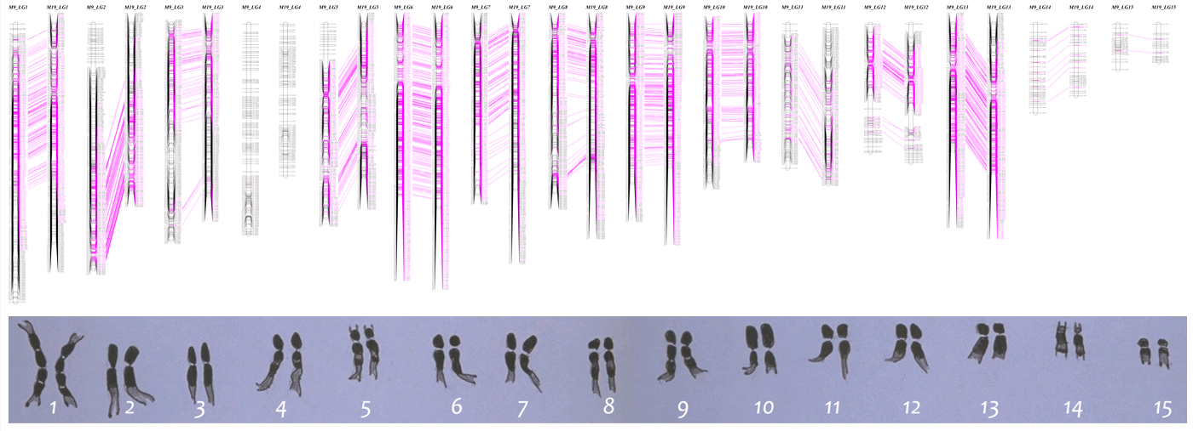
Validating and Checking Linkage Map Quality
Heatmap of pair-wise “Recombination fraction”
Marker Collinearity with other maps (genetic and physical) or parental map within the same cross.

Slide 33
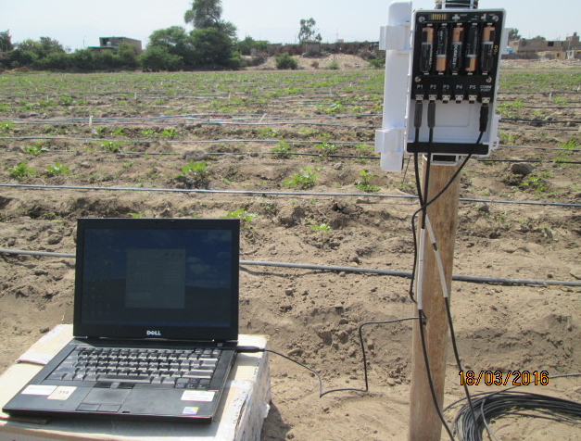
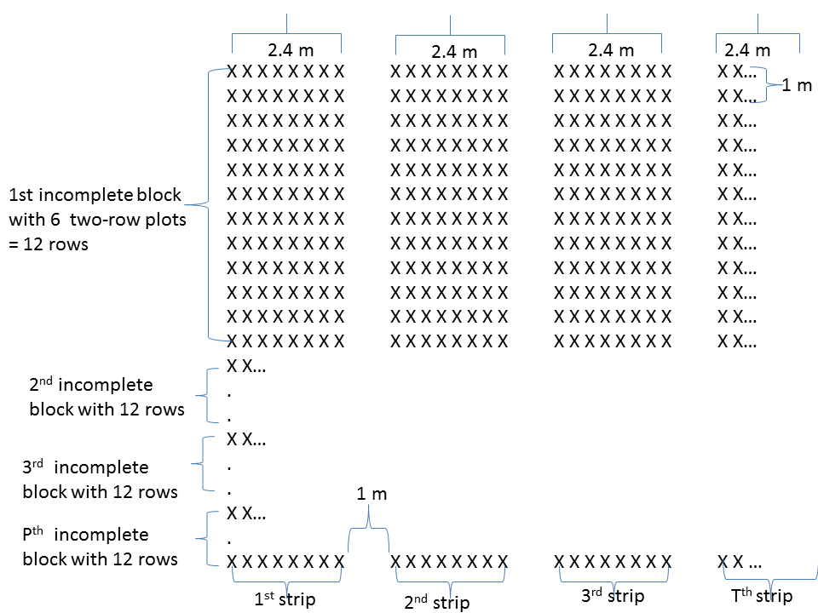
Phenotyping experiments for QTL tagging in sweetpotato
Reduction of environmental variance is paramount
Proper field designs to compare the large number of required genotypes without bias
Precise data collection

Slide 34
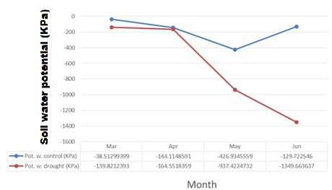
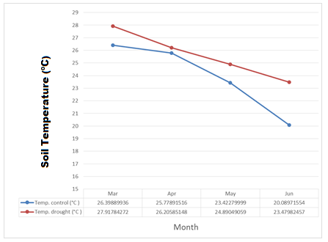
Phenotyping experiments for QTL tagging in sweetpotato
TIME | Average TEMP. (°C) | Average of HR (% ) | Average SOIL CONTROL Temp (°C) | Average SOIL DROUGHT Temp (°C) | Average PRECIPITATION (mm) | Average PAR (uE) | Average WIND SPEED (m/s)
Feb | 25.74 | 68.26 | 26.70 | 26.51 | 0.00 | 330.34 | 1.86
Mar | 25.42 | 65.37 | 27.85 | 27.53 | 0.00 | 414.70 | 2.03
Apr | 23.25 | 67.81 | 26.48 | 26.37 | 0.00 | 393.58 | 1.79
May | 19.67 | 70.01 | 24.90 | 25.45 | 0.00 | 342.64 | 1.31
Jun | 17.48 | 75.54 | 24.07 | 23.85 | 0.00 | 252.02 | 1.07
Grand Total | 22.14 | 69.10 | 26.11 | 26.03 | 0.00 | 359.09 | 1.63

Slide 35
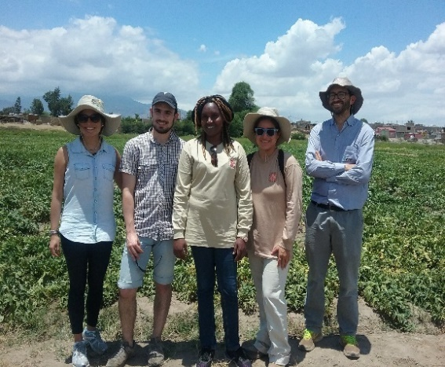
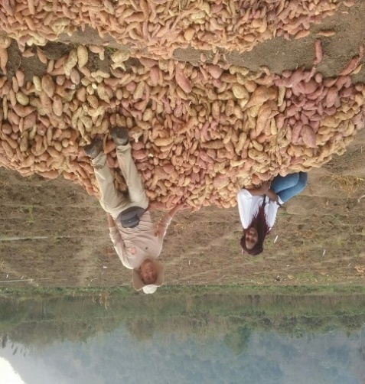
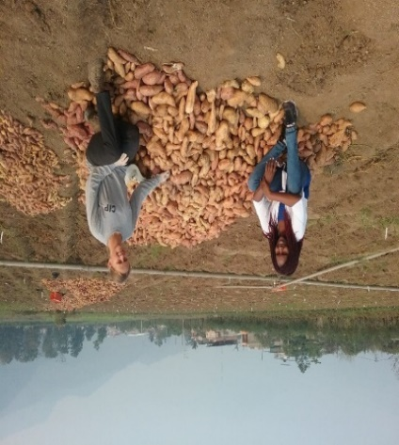
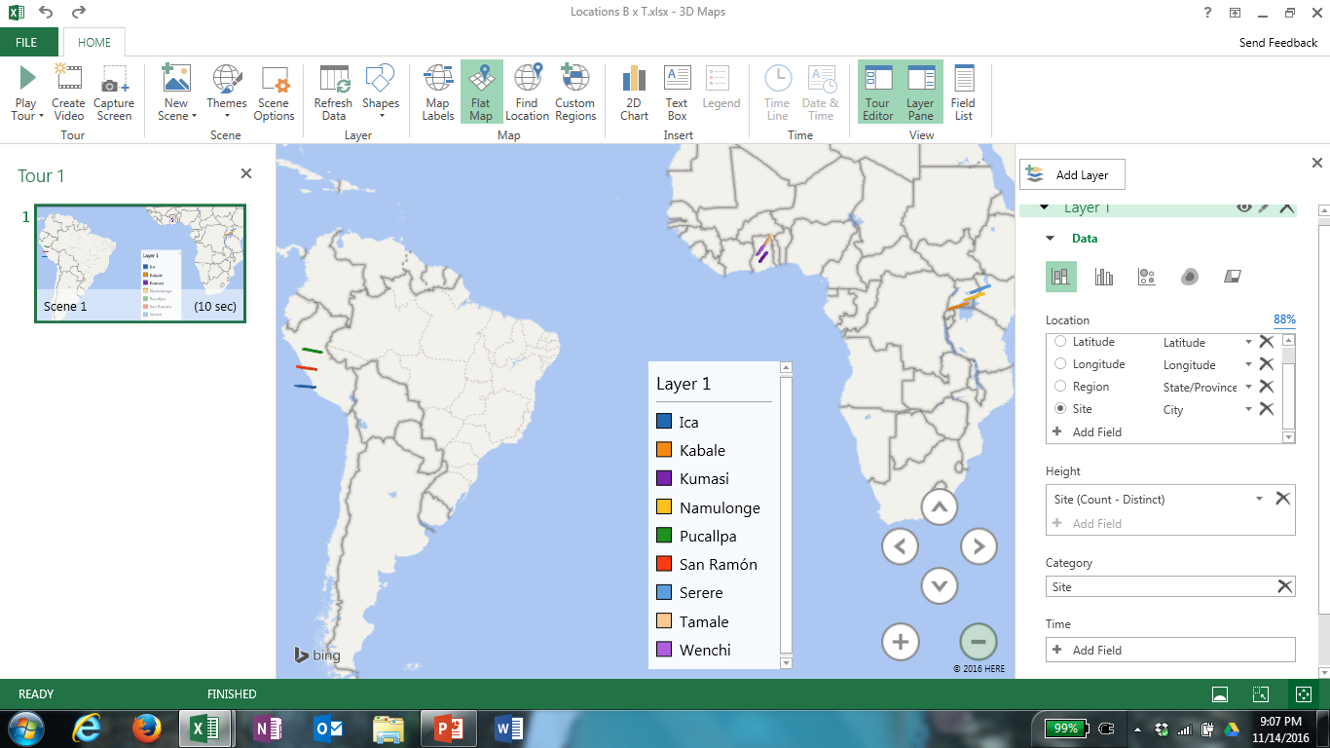




Sweetpotato populations for genetic analysis in GT4SP Project
Multi-environment evaluation is required to map alleles expressed in different environments
Ica-Peru
San Ramon-Peru
BxT evaluation sites:
Peru
Ghana
Uganda
Pucallpa-Peru
Kumasi-Ghana
Tamale-Ghana

Slide 36


Quality control (QC) of the phenotypic data
Raw data examination is a priority first step before data analysis:
  Measure of central tendency and the spread of data around this central tendency.
  Generalized mixed models assume normality of the data.
  Identify and remove extreme outlier
  Also allows to make decisions on subsequent data analysis.
Fig. QC of B x T data from six experiments in Peru between 2016 and 2017, for commercial root weight and vine weight

Slide 37


Considerations before phenotypic data analysis
Important: Analysis begins with context, is driven by context, and ends with the results being interpreted in the context of the original data
What if data is not normally distributed? To transform or not transform?
Skewed data without outliers may have a biological implication e.g. trait conditioned by a major QTL

Slide 38
Considerations before phenotypic data analysis
Results of standard statistical tests performed on log-transformed data are often not relevant for the original, non-transformed data
Furthermore, estimating the mean of the original population using the exponent or anti-log of the sample mean of the transformed data can generate inaccurate estimates of the true population mean of the original data
Use transformation cautiously
As a rule of thumb, for large sample size (n>30) the sampling distribution tends to be normal, regardless of the shape of the data

Slide 39
Important quantitative genetic parameters
Combined analysis across six environments
Single environment analysis for Commercial root weight in BxT
Envt | σ²_{g} | sed | µ±se | Cv_{e} | Cσ²_{g} | w² | Sig
IcaC2016 | 97.92 | 6.38 | 25.8±6 | 24.74 | 38.35 | 0.83 | ***
IcaD2016 | 26.99 | 6.01 | 14.6±6 | 41.16 | 35.59 | 0.60 | ***
IcaC2017 | 78.08 | 5.25 | 20.2±5 | 25.98 | 43.74 | 0.85 | ***
IcaD2017 | 18.44 | 3.27 | 9.2±3 | 35.51 | 46.68 | 0.78 | ***
SR2016 | 34.73 | 2.49 | 20.9±2.5 | 11.90 | 28.20 | 0.92 | ***
PUC2016 | 22.57 | 3.68 | 15.1±3.6 | 24.37 | 31.46 | 0.77 | ***
Random term | Estimate
Geno | 28.25***
Geno x Envt | 17.74***
µ±se | 17.63±3
Cσ²_{g} | 30.1
Cv_{e} | 19.5
h² | 0.79
Repeatability per experiment: W² = σ²_{g} /[σ²_{g} + (VD/2)] where VD=sed²
Standardized coefficient of error: CVe = Sqrt VD/µ
Standardized coefficient of genetic variation: Cσ²_{g} = sqrt σ²_{g} /µ
Broadsense heritability across environments: h²= 1- (V_{BLUP}/2 σ²_{g})

Slide 40
Dosage-dependent QTL mapping and marker-trait associations
Genotypic data
Marker-trait associations (QTL)
Phenotypic data
Linkage map
QTL analysis:
  - No existing software that accounts for dosage effects.
Genome-wide association analysis
  GWASpoly (R-package)

Slide 41
Outline
Markers and Next-Generation Genotyping Platforms
Marker-Assisted Selection (MAS) for Sweetpotato Improvement
Linkage, QTL and Genome-Wide Association Analysis
Genomic Selection (GS)
Suggested Discussion points

Slide 42

GAB II: Genomic Selection
Using all available markers to predict the breeding value of a given genotype
Does not require prior QTL tagging
Requires high density markers to improve selection accuracy
Effective for quantitative traits with low heritability
Bhat et al. (2016) Frontiers in Genetics.

Slide 43

Genomic Selection in Sweetpotato: Strategy-1
Xiaofei Zhang et al. (Dept. Hort. Sci., NCSU, Unpublished)

Slide 44

Genomic Selection in Sweetpotato: Strategy-2
Xiaofei Zhang et al. (Dept. Hort. Sci., NCSU, Unpublished)

Slide 45


Factors affecting accuracy of GS and how they relate to sweetpotato
1. Heritability of the traits
2. Size of the reference population
Slater et al (2016)
Wray et al. (2013)
The larger the better
Expected to be larger for sweetpotato (higher number of segregating alleles)
Not yet determined for sweetpotato
The higher the heritability the better
GxE an important consideration

Slide 46

Factors affecting accuracy of GS and how they relate to sweetpotato
No of generations after model training
Genetic architecture of the trait
Other factors related to over-estimation of model
Not a problem for sweetpotato in GS for variety development
  Variety is ‘genetically identical’ to original seed plant
Problem in population improvement
  Different allele combinations in progeny
  Shorter generation interval between model training and use for sweetpotato
The lower the number of QTL responsible for the trait, the better
Genetic architecture is more complex in sweetpotato
  Even normally simple traits like disease resistance behave quantitatively
Effects of allele substitution at a locus cannot be fully determined
Overlapping training and validation sets
Close relationship between training and validation set relative to breeding set
Large number of markers, small sample size i.e. ‘large P small n’

Slide 47
Way forward towards GS in sweetpotato
What to do with sweetpotato breeders
Need to define traits of interest to each breeding program that are suitable for GS
Need to define the breeding populations and the effective population size (Ne) for a given breeding program
Need to define possible heterotic groups that allow better cross prediction
Need to define target environments for each breeding program
How to incorporate GS in the breeding programs

Slide 48
Outline
Markers and Next-Generation Genotyping Platforms
Marker-Assisted Selection (MAS) for Sweetpotato Improvement
Linkage, QTL and Genome-Wide Association Analysis
Genomic Selection (GS)
Suggested Discussion points

Slide 49
Discussion points
Why do we need to use DNA markers for plant breeding?
Which traits are of the highest priority for marker development?
When does molecular breeding give an important advantage over conventional breeding, and how can we exploit this?
How different are the parents in our breeding programs?
How can we further minimize costs and increase efficiency in sweetpotato breeding?

